Slide 1
PMTest: A Fast and Flexible Testing Framework for Persistent Memory Programs
Sihang Liu¹, Yizhou Wei¹, Jishen Zhao², Aasheesh Kolli^{3,4}, and Samira Khan¹
1
2
3
4

Slide 2
SUMMARY
The new persistent memory (PM) allows direct management of persistent data in memory
However, it is hard to guarantee crash consistency
PMTest detects such crash consistency bugs and performance bugs
PMTest is flexible
Supports kernel modules, custom PM programs, transaction-based programs, etc.
Can be extended to different PM hardware platforms
PMTest is fast
7X faster than the state-of-the-art tool
Less than 2X overhead in real-workload applications
We have detected 3 new bugs in PMFS and PMDK applications with PMTest

Slide 3
BACKGROUND
The new persistent memory (PM) is
High-speed
Persistent
Byte-addressable
Benefit of using PM
Direct manipulation of persistent data in memory
No file system overhead
Intel DCPMM

Slide 4
INTEGRATION OF PM
Using PM
File System
PM-DIMM
Program guarantees crash consistency
The file system guarantees crash consistency
Notes:
Next, I will introduce how PM is integrated in the system
Conventionally, programs need to go through the file system to manage persistent data, and the file system guarantees crash consistency. With PM, programs can directly manage persistent data in-memory. However, the program needs to guarantee crash consistency

Slide 5
PERSISTENCY PROGRAMMING
Support for crash consistency have two fundamental guarantees
Durability: writes become persistent in PM
Core
Volatile
Cache
Persistent
PM-DIMM
Notes:
There are two fundamental guarantees for programs to ensure crash consistency
The first guarantee is the durability guarantee, that writes can become persistent in PM
In this example, the cache in the processor is volatile. The durability guarantee makes sure data in the volatile cache can be written back to PM and become persistent

Slide 6
PERSISTENCY PROGRAMMING
Support for crash consistency have two fundamental guarantees
Durability: writes become persistent in PM
Ordering: one write becomes persistent in PM before another
Core
Volatile
Cache
Persistent
PM-DIMM
Notes:
The second guarantee is ordering, that ensures one write becomes persistent before another.
For example, the processor writes back one chunk of data first and makes sure it becomes persistent. Then it writes back the second chunk afterward.

Slide 7
PERSISTENCY PROGRAMMING
Support for crash consistency have two fundamental guarantees
Durability: writes become persistent in PM
Ordering: one write becomes persistent in PM before another
Hardware provides low-level primitives for crash consistency
sfence, clwb from x86
dc cvap from ARM
And academic proposals
x86
ARM
clwb
sfence
dc cvap
dsb
New Instr
PM-DIMM
PM-DIMM
PM-DIMM
[Kiln’13, ThyNVM’15, DPO’16, JUSTDOLogging’16, ATOM’17, HOPS’17, etc.]
Notes:
The HW provides low-level primitives for these two fundamental guarantees
For example, x86 provides sfence and clwb, and ARM provides dccvap.
There are also many other academic proposals

Slide 8
PROGRAM USING LOW-LEVEL PRIMITIVES
1 void listAppend(item_t new_val) {
2 node_t* new_node = new node_t(new_val);
3 new_node->next = head;
4 head = new_node;
5 persist_barrier();
6 }
2 node_t* new_node = new node_t(new_val);
Create new_node
3 new_node->next = head;
Update new_node
4 head = new_node;
Update head pointer
Writes to PM can reorder
Writeback updates
5 persist_barrier();
Head
In cache
new_node is lost after failure
Inconsistent linked list
Notes:
Now let’s take a look at how to use low-level primitives
This example is a function that appends a node to a linked list in PM.
First, it creates a new node. Second, it updates the new node’s next pointer. Third, it updates the head pointer to point to the new node. Finally, it uses a persist_barrier() to ensure all updates have been persisted to PM.
This example seems correct, however, line 3 and line 4 can get reordered. If the head gets persisted before the new node, and failure happens at this point, the new node is lost. And thus, the entire linked list is gone.

Slide 9
PROGRAM USING LOW-LEVEL PRIMITIVES
1 void listAppend(item_t new_val) {
2 node_t* new_node = new node_t(new_val);
3 new_node->next = head;
persist_barrier();
Enforce writeback before changing head
4 head = new_node;
5 persist_barrier();
6 }
Head
In cache
In PM
Ensuring crash consistency with low-level primitives is HARD!
Consistent linked list
Notes:
To fix it, we need to insert a persist_barrier() between these two lines. This way, the new node is guaranteed to be persisted before the update of the head. Even failure happens, the linked list is still consistent.
We conclude that it is hard to guarantee crash consistency with low-level primitives.

Slide 10
PERSISTENCY PROGRAMMING
Support for crash consistency have two fundamental guarantees
Durability: writes become persistent in PM
Ordering: one write becomes persistent in PM before another
Hardware provides low-level primitives for crash consistency
sfence, clwb from x86
dc cvap from ARM
And academic proposals
Libraries provide transactions on top of low-level primitives
Intel’s PMDK
And academic proposals
[NV-Heaps’11, Mnemosyne’11, ATLAS’14, REWIND’15, NVL-C’16, NVThreads’17 LSNVMM’17, etc.]
Notes:
How to make it easier? There have been library support that provides transactions or higher-level interface on top of these low-level primitives. Such as Intel’s PMDK. And there are many other academic proposals.

Slide 11
PROGRAM USING TRANSACTIONS
1 void ListAppend(item_t new_val) {
2 TX_BEGIN {
3 node_t *new_node = makeNode(new_val);
4 TX_ADD(list.head, sizeof(node_t*));
5 List.head = new_node;
6 List.length++;
7 } TX_END
8 }
3 node_t *new_node = makeNode(new_val);
Create new_node
4 TX_ADD(list.head, sizeof(node_t*));
backup head
5 List.head = new_node;
Update head
6 List.length++;
Update length
length is not backed up before update!
Notes:
Here is an example that uses the PMDK transaction to implement the same function.
Similarly, it first creates a new node. Before updating the head, it backs it up by TX_ADD. And then it performs the update to the head, and increments the length of the list.
In this example, the length gets updated without calling TX_ADD. So the list can have an inconsistent length.

Slide 12
PROGRAM USING TRANSACTIONS
1 void ListAppend(item_t new_val) {
2 TX_BEGIN {
3 node_t *new_node = makeNode(new_val);
4 TX_ADD(list.head, sizeof(node_t*));
5 List.head = new_node;
TX_ADD(list.length, sizeof(unsigned));
6 List.length++;
7 } TX_END
8 }
Backup length before update
Ensuring crash consistency with transactions is still HARD!
Notes:
To fix this, we need to call TX_ADD on the length before update.
We conclude that ensuring crash consistency with transactions is still hard.

Slide 13
PERSISTENCE PROGRAMMING IS HARD
How to ensure crash consistency?
We need a tool to detect crash consistency bugs!
Notes:
The question we’d like to ask is how do we ensure crash consistency?
The answer is we need a tool that detects crash consistency bugs.

Slide 14
OUTLINE
BACKGROUND AND MOTIVATION
REQUIREMENTS AND KEY IDEAS
PMTEST INTERFACE
PMTEST MECHANISM
EVALUATION
SUMMARY
Notes:
So far, I have talked about the background and motivation. Next, I will move on to the requirements of such tool and our key ideas in PMTest.

Slide 15
REQUIREMENTS OF THE TOOL
Fast
Flexible
PM Libraries
Kernel Modules
Custom Programs
Existing HW
Academic Proposals
[PMDK, NV-Heaps’11, Mnemosyne’11, ATLAS’14, REWIND’15, NVL-C’16, NVThreads’17 LSNVMM’17, etc.]
[PMFS’14, BPFS’09, NOVA’16, NOVA-Fortis’17, Strata’17, SCMFS’11 etc.]
[DPO’16, HOPS’17, etc.]
E.g., custom database, key-value store, etc.
[x86, ARM, etc.]
Notes:
There are two requirements of the tool.
First, it needs to be fast, so that we can test as many cases as we can to detect more bugs.
Second, it needs to be flexible. There can be different types of software for PM. Such as kernel modules, like a PM-optimized file system, PM libraries, and custom programs such as key-value store.
There can also be different hardware platforms for PM. Such as the existing systems and future academic proposals

Slide 16
PMTEST KEY IDEAS: FLEXIBLE
Prior works only support specific software and hardware
If the tool can test these two fundamental guarantees
It can cover all these variations
PM Program
PM Program
PM Kernel Module
Call library
Call library
PMDK Library
Mnemosyne Library
write, sfence, clwb
write, dc cvap, dsb
write, sfence, clwb
x86
ARM
x86
The challenge is to support different
HW platforms and SW
Operations that maintain crash consistency are similar:
guarantees of ordering and durability
[Yat, Pmemcheck, Persistence Inspector, etc.]
Notes:
First, I will introduce the key ideas that makes our tool flexible.
Prior works only support specific SW and HW. However, there can be variable SW and HW variations.
For example, the program can use PMDK library and execute on x86.
It can also use other libraries, say Mnemosyne, and runs on ARM.
It can also be a kernel module such as a file system that uses low-level x86 primitives.
We observe that even through there are variations, the operations that maintain crash consistency are similar. They all guarantees ordering and durability.
If the tool can test these two fundamental guarantees, it covers all these variations.

Slide 17
PMTEST KEY IDEAS: FAST
Prior work [Yat’14] uses exhaustive testing
sfence
write A
write B
write C
...
sfence
sfence
write B
write A
write C
...
sfence
sfence
write C
write B
write A
...
sfence
sfence
write A
write C
write B
...
sfence
sfence
write B
write C
write A
...
sfence
sfence
write C
write A
write B
...
sfence
O(n!)
n
Recoverable?
Notes:
Next I will introduce the key idea that makes our tool fast.
Prior works uses exhaustive testing. Given a trace of PM operations, it permutes all possible reorderings and check whether each case is recoverable after failure.
If the length of the trace is n, then there are O(n!) cases.

Slide 18
PMTEST KEY IDEAS: FAST
Prior work [Yat’14] uses exhaustive testing
sfence
write C
write B
write A
...
sfence
Test at runtime
Recoverable?
Notes:
What we desire is to test at runtime. Given a single trace, and determine whether it is recoverable or not.

Slide 19
PMTEST KEY IDEAS: FAST
Prior work [Yat’14] uses exhaustive testing
PMTest infers the persistence interval from PM operation trace The interval in which a write can possibly become persistent
write A
A
clwb A
sfence
A persists before B
write B
B
clwb B
sfence
Trace
Timeline
Notes:
Our solution is to infer the persistence interval from the trace, which is the interval in which a write can possibly become persistent
In this example, we show both the trace and the interval we infer.
First, the write starts an interval for location A until it gets written back to PM with clwb; sfence.
Then, another write to B starts a second interval for location B.
We can say that A persists before B according to the persistence interval.

Slide 20
PMTEST KEY IDEAS: FAST
Prior work [Yat’14] uses exhaustive testing
PMTest infers the persistence interval from PM operation trace The interval in which a write can possibly become persistent
write A
Interleaving
A
write B
B
clwb A
sfence
A may NOT persist before B
clwb B
sfence
Trace
Timeline
Notes:
In another example, we can have the two persistence intervals interleaving. In this case, we cannot say A persists before B because both of them can possibly become persistent during the interleaving interval.

Slide 21
PMTEST KEY IDEAS: FAST
Prior work [Yat’14] uses exhaustive testing
PMTest infers the persistence interval from PM operation trace The interval in which a write can possibly become persistent
write A
A
write B
B
clwb A
sfence
clwb B
sfence
A persists before B?
Trace
Timeline
Notes:
Based on persistence intervals, we can let programmers ask questions, such as if A persists before B, and check whether the program meets our requirements of crash consistency.
Then the question is how do we let them ask this question?

Slide 22
OUTLINE
BACKGROUND AND MOTIVATION
REQUIREMENTS AND KEY IDEAS
PMTEST INTERFACE
PMTEST MECHANISM
EVALUATION
SUMMARY

Slide 23
PMTEST OVERVIEW
Testing Annotation
Checking Rules
Crash consistent software
PMTest
Testing
Results
Offline
Online
Notes:
Next I will introduce the interface of PMTest for annotation.

Slide 24
PMTEST OVERVIEW
Testing Annotation
Checking Rules
Crash consistent software
PMTest
Testing
Results
Offline
Online

Slide 25
PMTEST INTERFACE
PMTest
Expert
Normal
Assertion-like low-level interface
Check behavior vs. specification
High-level interface
Minimize programmer’s effort
Automatically inject low-level checkers
The PMTest interface is HW-independent
Notes:
The PMTest interface has two parts.
The first part targets expert programmers. We provide assertion-like low-level interface that checks whether the behavior satisfies the specification
The second interface targets normal programmers. We provide high-level interface to minimize programmer’s effort. The high-level interface can automatically inject low-level checkers
Again, our interface is HW-independent, as we have abstracted the differences in HW

Slide 26
PMTEST LOW-LEVEL INTERFACE
Two low-level checkers
isOrderedBefore(A, sizeA, B, sizeB)
Checks whether A is persisted before B
IsPersisted(A, sizeA)
Checks whether A has been written back to PM
Notes:
The low-level interface consists of two low-level checkers.
isOrderedBefore checks if one write is persisted before another. This corresponds to the ordering guarantee.
isPersisted checks if certain location has been written back at some point in the program. This corresponds to the durability guarantee.

Slide 27
PMTEST LOW-LEVEL INTERFACE
Two low-level checkers
isOrderedBefore(A, sizeA, B, sizeB)
Checks whether A is persisted before B
IsPersisted(A, sizeA)
Checks whether A has been written back to PM
Help check if implementation meets specification for
Programs/kernel modules based on low-level primitives
PM libraries
Notes:
The low-level interface can help expert programmers check if the implementation meets the specification for programs or kernel modules that use low-level interface or their PM libraries

Slide 28
EXAMPLE
void hashMapRemove() {
...
remove(buckets->bucket[hash]);
count--;
persist_barrier();
...
hashmap_rebuild();
isOrderedBefore(&count, sizeof(unsigned), &hashmap, sizeof(hashmap));
isPersisted(&hashmap, size);
}
Check if count has been persisted before rebuilding
Check if all updates have been persisted in rebuilding
*This example is inspired by hashmap_atomic from PMDK
Notes:
Here is an example that demonstrates the use of low-level interface.
The first isOrderedBefore checker checks if the count has been persisted before rebuilding the hashmap
And the second isPersisted checker checks if the hashmap_rebuild function has written back all updates to memory

Slide 29
PMTEST LOW-LEVEL INTERFACE
Two low-level checkers
isOrderedBefore(A, sizeA, B, sizeB)
Check whether A is persisted before B
IsPersisted(A, sizeA)
Check whether A has been written back to PM
Help check if implementation meets specification for
Programs/kernel modules based on low-level primitives
PM libraries
Further enables high-level checkers to automate testing
Notes:
The low-level checkers can further enable us to build high-level checkers to automate testing

Slide 30
PMTEST HIGH-LEVEL INTERFACE
Currently provides high-level checkers for PMDK transactions
Automatically detects crash consistency bugs
void ListAppend(item_t new_val) {
TX_CHECKER_START; //Start of TX checker
TX_BEGIN {
node_t *new_node = makeNode(new_val);
TX_ADD(list.head, sizeof(node_t*));
List.head = new_node;
List.length++;
} TX_END
TX_CHECKER_END; //End of TX checker
}
Automatically check if there is a backup before update
Automatically check if all updates have been persisted
* This example does not include initialization and communication with PMTest
Notes:
We current provides high-level checkers for PMDK transactions
It can automatically detect crash consistency bugs.
In this example, we simple need to place TX_CHECKER_START and TX_CHECKER_END around the outermost transaction. At runtime, it automatically checks if there is always a backup before update
In the end of the transaction, it automatically checks if all updates have been persisted.

Slide 31
PMTEST HIGH-LEVEL INTERFACE
Currently provides high-level checkers for PMDK transactions
Automatically detects crash consistency bugs
If all updates have been persisted at the end of the transaction
If there is a backup before update during the transaction
Automatically detects performance bugs
Redundant log/backup
Duplicated writeback/flush operations (for all programs)
High-level checkers minimize programmer’s effort
Notes:
Our high-level checker can also detect performance bugs. Including redundant backups or duplicated writebacks. The functionality of checking duplicated writebacks is not restricted to PMDK transaction but also applies to other software.

Slide 32
OUTLINE
BACKGROUND AND MOTIVATION
REQUIREMENTS AND KEY IDEAS
PMTEST INTERFACE
PMTEST MECHANISM
EVALUATION
SUMMARY

Slide 33
PMTEST OVERVIEW
Testing Annotation
Checking Rules
Crash consistent software
PMTest
Testing
Results
Offline
Online
Notes:
So far, we have talked about the annotation, next I will introduce how PMTest works.

Slide 34
PMTEST OVERVIEW
Testing Annotation
Checking Rules
Crash consistent software
PMTest
Testing
Results
Offline
Online

Slide 35
PMTEST CHECKING MECHANISM
Auto inject low-level checkers for high-level checkers
for (...) {
TX_CHECKER_START;
TX_BEGIN;
...
TX_END;
TX_CHECKER_END;
PMTest_SEND_TRACE;
}
...
write A
write B
clwb B
sfence
TX_END
Checking
Engine
Checking
Engine
Result:
A is not persistent!
Algorithm?
Implementation?
System Integration?
At Runtime
PM Trace
We answer three questions
Notes:
The runtime checking mechanism is as follows:
At runtime, the program passes a trace of PM operations to PMTest. It atomically injects low-level checkers for the high-level checkers placed by programmers.
Then, the checking engine performs checking and report the results.
We answer three questions for the design of checking engine. First, what is an efficient algorithm for checking. Second, how do we implement this algorithm and finally how to integrate it into a real system.

Slide 36
CHECKING ENGINE ALGORITHM
Infer the persistence interval in which a write can become persistent
Check the interval against the low-level checkers
sfence
sfence
A
B
write A
A and B can be persisted any time
clwb A
write B
sfence
sfence
isOrderedBefore A B
B may not persist
isPersist B
Time
PM Trace
Persistence Interval
Notes:
The algorithm, as I have briefly introduced earlier, infers the persistence interval in which a write can become persistent.
In this example, write A first starts an interval for A. Then the clwb A is issued but it is not guaranteed to write it back. Then write B starts the interval for B.
Finally, the sfence ensures the previous writeback of A.
Then, the checking engine checks against the checkers, that are tracked together with PM operations. The first one asks whether A persists before B. The answer is no, because the intervals interleave.
The second one asks whether B has been persisted. The answer is also no because the persistence interval of B has not ended.

Slide 37
CHECKING ENGINE EXECUTION
Transaction 1
Transaction 2
Transaction 3
Execution
Timeline
Testing
Engine
Test Trace 1
Test Trace 2
Test Trace 3
Testing traces in serial is slow

Slide 38
CHECKING ENGINE EXECUTION
Transaction 1
Transaction 2
Transaction 3
Execution
Timeline
Worker 1
Test Trace 1
Test Trace 3
Worker 2
Test Trace 2
PMTest checks independent traces in parallel
Notes:
The next question is how do we implement the checking engine?
For example, the program executes a series of independent traces.
To speedup checking, PMTest checks them in parallel with multiple checking engine workers.
Worker 1 first checks the trace of transaction 1. While it is checking transaction 1, work 2 can check the trace of transaction 2. Now worker 1 has completed checking and then can start checking the next trace.

Slide 39
SYSTEM INTEGRATION
User-space
User-space
PMTest
Shared Memory
Kernel FIFO
PMTest
PM Program
PM Kernel Module
Kernel
Persistent Memory
Persistent Memory
Efficient testing for both user-space programs and kernel modules
Notes:
Finally, I will talk about the system integration.
For userspace programs, we let PMTest run with the program in the same process so that we can use shared memory to pass traces.
However, this does not work for kernel modules. Alternatively, we use a kernel FIFO to pass the trace.
Our implementation can efficiently test both user-space programs and kernel modules.

Slide 40
OUTLINE
BACKGROUND AND MOTIVATION
REQUIREMENTS AND KEY IDEAS
PMTEST INTERFACE
PMTEST MECHANISM
EVALUATION
SUMMARY

Slide 41
METHODOLOGY
Platform
CPU: 8-core Skylake 2.1GHz
Memory: 64GB DDR4
NVM: 64GB Battery-backed NVDIMM
OS: Ubuntu 14.04, Linux kernel 4.4
Compiler: gcc/g++-4.8.4, O3
Notes:
Here is our platform for evaluation

Slide 42
METHODOLOGY
Workloads
Micro-benchmarks (from PMDK)
C-Tree
B-Tree
RB-Tree
HashMap
Real-world workloads
PM-optimized file system
Intel’s PMFS (kernel module)
PM-optimized database
Redis (PMDK Library)
Memcached (Mnemosyne Library)
Baselines
No testing tool
With Intel’s Pmemcheck (only for PMDK-based programs)
Notes:
We have two types of workloads.
The microbenchmarks are from PMDK
And the real-world workloads include Intel’s PM-Optimized file system PMFS, and two PM-optimized databases: Redis and Memcached
We have two baselines.
The first one is running them without using any testing tool.
The second one is running with Pmemcheck. The circled software are built on PMDK, so they can be checked by Pmemcheck.

Slide 43
MICRO-BENCHMARK
Speedup vs. Pmemcheck
(Transaction)
PMTest is 7.1X faster than Pmemcheck
Notes:
The first evolution shows the performance on micro-benchmarks. The y-axis shows the speedup of PMTest vs. Pmemcheck.
On average, PMTest is 7x faster.

Slide 44
REAL-WORLD WORKLOADS
22X slowdown with Pmemcheck
PMTest has < 2X overhead in real-world workloads
Notes:
The next evaluation shows its performance on real-world workloads with different client applications.
The y-axis shows the overhead from PMTest over the baseline without any testing tool.
On average, PMTest only incurs less than 2x overhead.
We also tested Redis with Pmemcheck. It shows a 22x slowdown. So the speedup of PMTest over Pmemcheck in this particular case is more than 10x.

Slide 45
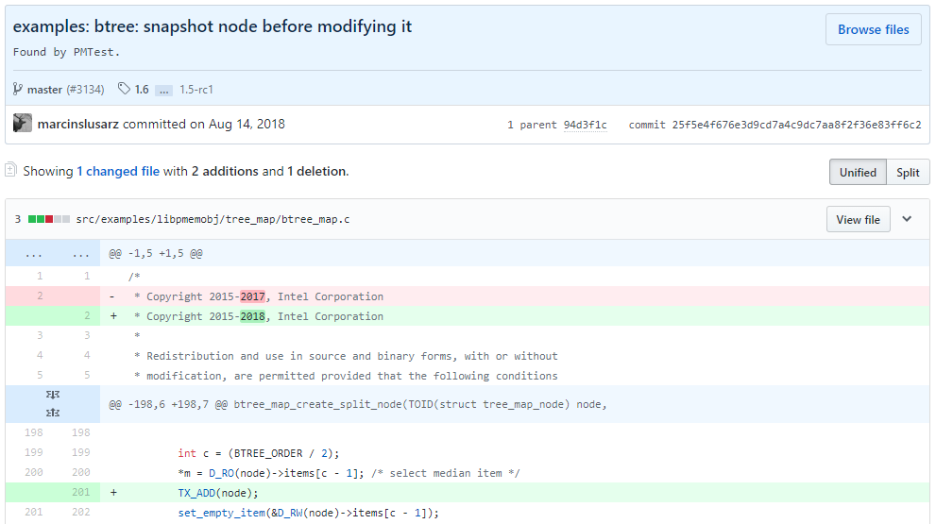
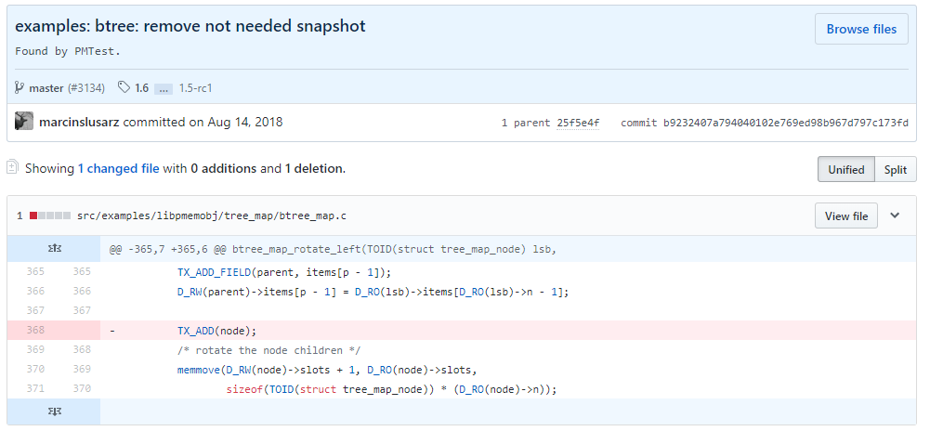
BUG DETECTION
Validated with
42 synthetic bugs injected to micro-benchmarks
3 existing bugs from commit history
New bugs found
1 crash consistency bug in PMDK applications
1 performance bug in PMFS
1 performance bug in PMDK applications
Notes:
The final evaluation is on bug detection.
We have validated PMTest with 42 manually crafted bugs and 3 bugs we found in the commit history of our workloads.
We also detected three new bugs.
Here are the screen shots of the bug fixes by the developers for PMDK applications

Slide 46
OUTLINE
BACKGROUND AND MOTIVATION
REQUIREMENTS AND KEY IDEAS
PMTEST INTERFACE
PMTEST MECHANISM
EVALUATION
CONCLUSION

Slide 47
CONCLUSION
The new persistent memory (PM) allows direct management of persistent data in memory
However, it is hard to guarantee crash consistency
PMTest detects such crash consistency bugs and performance bugs
PMTest is fast and flexible
Supports kernel modules, custom PM programs, transaction-based programs, etc.
Can be extended to support future PM hardware platforms
Incurs < 2X overhead in real-workload applications
PMTest has detected 3 new bugs in PMFS and PMDK applications
Source code is available at pmtest.persistentmemory.org

Slide 48
PMTest: A Fast and Flexible Testing Framework for Persistent Memory Programs
Sihang Liu¹, Yizhou Wei¹, Jishen Zhao², Aasheesh Kolli^{3,4}, and Samira Khan¹
1
2
3
4

Slide 49
BACKUP SLIDES

Slide 50
SCALABILITY
Memcached Clients:
PMTest
Overhead
#Workload clients
(1x PMTest worker)
#PMTest workers
(4x workload clients)
#PMTest workers and workload clients
Using multiple workers significantly reduces overhead

Slide 51
PM OPERATION TRACKING
PMTest extends the macros from WHISPER to track PM operations
Future works can use similar methods or use tool chains to inject tracking functions

Slide 52
ANOTHER EXAMPLE
void listAppend(item_t new_val) {
node_t* new_node = new node_t(new_val);
new_node->next = head;
head = new_node;
persist_barrier();
isOrderedBefore(new_node, sizeof(node_t),
&head, sizeof(note_t*));
isPersisted(new_node, sizeof(node_t));
isPersisted(&head, sizeof(node_t*));
}
Make sure new_node persists
before switching head
Make sure all updates have been persisted
Notes:
Talk about library semantics
Help normal programmers understand
Programmer can do annotation != do correct programming
Black box testing?

Slide 53
USING PMTEST INTERFACE
We provide two types of interface to programmers
Low-level interface for expert programmers
High-level interface for normal programmers
Low-level
We expect expert programmers have a good idea about the algorithmic correctness of the program
The low-level interface can help detect mistakes in implementation
High-level
Using the high-level interface requires minimum programmer effort without expert knowledge about the program
Correctly using the high-level interface is trivial

