Slide 1
ARMOR:
Towards Restricted Approximation with A Worst-Case Guarantee
Sihang Liu, Kevin Angstadt, Mike Ferdman, and Samira Khan

Slide 2
BACKGROUND
APPROXIMATE MEMORY
Failures
DRAM Scaling
It is possible to enable scaling & tolerate failures
by adopting approximate memory
[Liu’11, Sampson’11, Guo’16, Chen’16, etc.]

Slide 3
BACKGROUND
APPROXIMATE MEMORY
Approximate memory provides
performance improvement and energy reduction

Slide 4
BACKGROUND
APPROXIMATE MEMORY
Original image
Image with errors
Indistinguishable
Many applications are resilient to errors
[Sampson’11, Carbin’12, Misailovic’14, Sampson’15, Hoffmann’15, Mahajan’16, etc.]

Slide 5
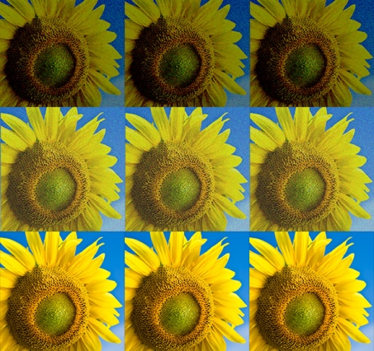
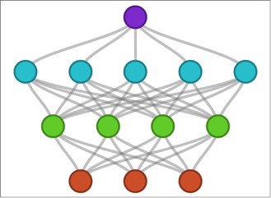

BACKGROUND
APPROXIMATE APPLICATIONS
Gaming
Image Processing
Neural Network
Data Analytics

Slide 6
PROBLEM
FAILURES ARE RANDOMLY DISTRIBUTED
High Error
S
Exponent
Mantissa
MSB
LSB
Low Error
S
Exponent
Mantissa
MSB
LSB
Error depends on the location of the failure
[IEEE754 float32]

Slide 7
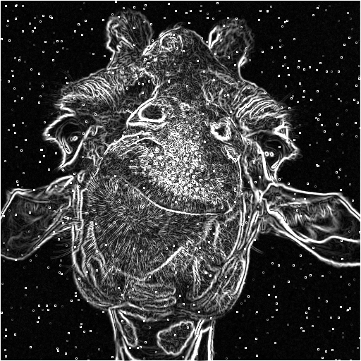

PROBLEM
CHALLENGE OF APPROXIMATE MEMORY
The output of Sobel with the same input error rate
Hard to guarantee error in the output

Slide 8
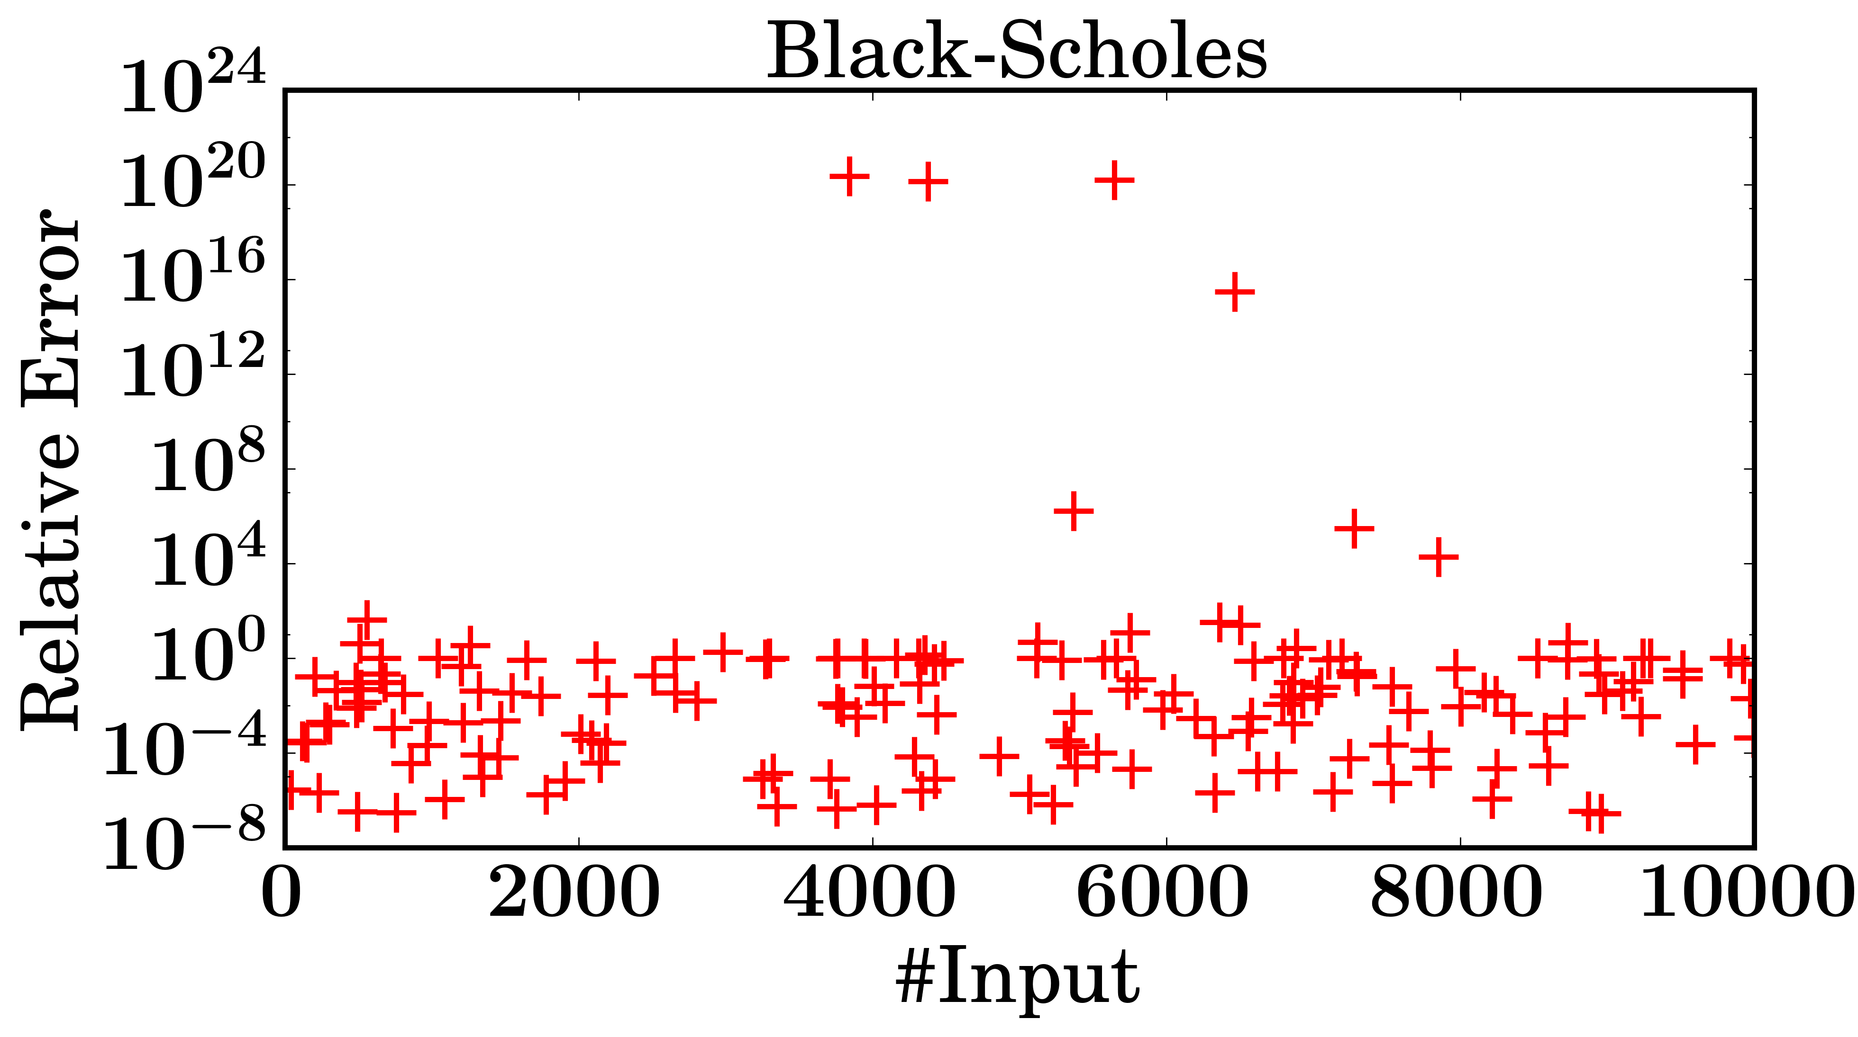
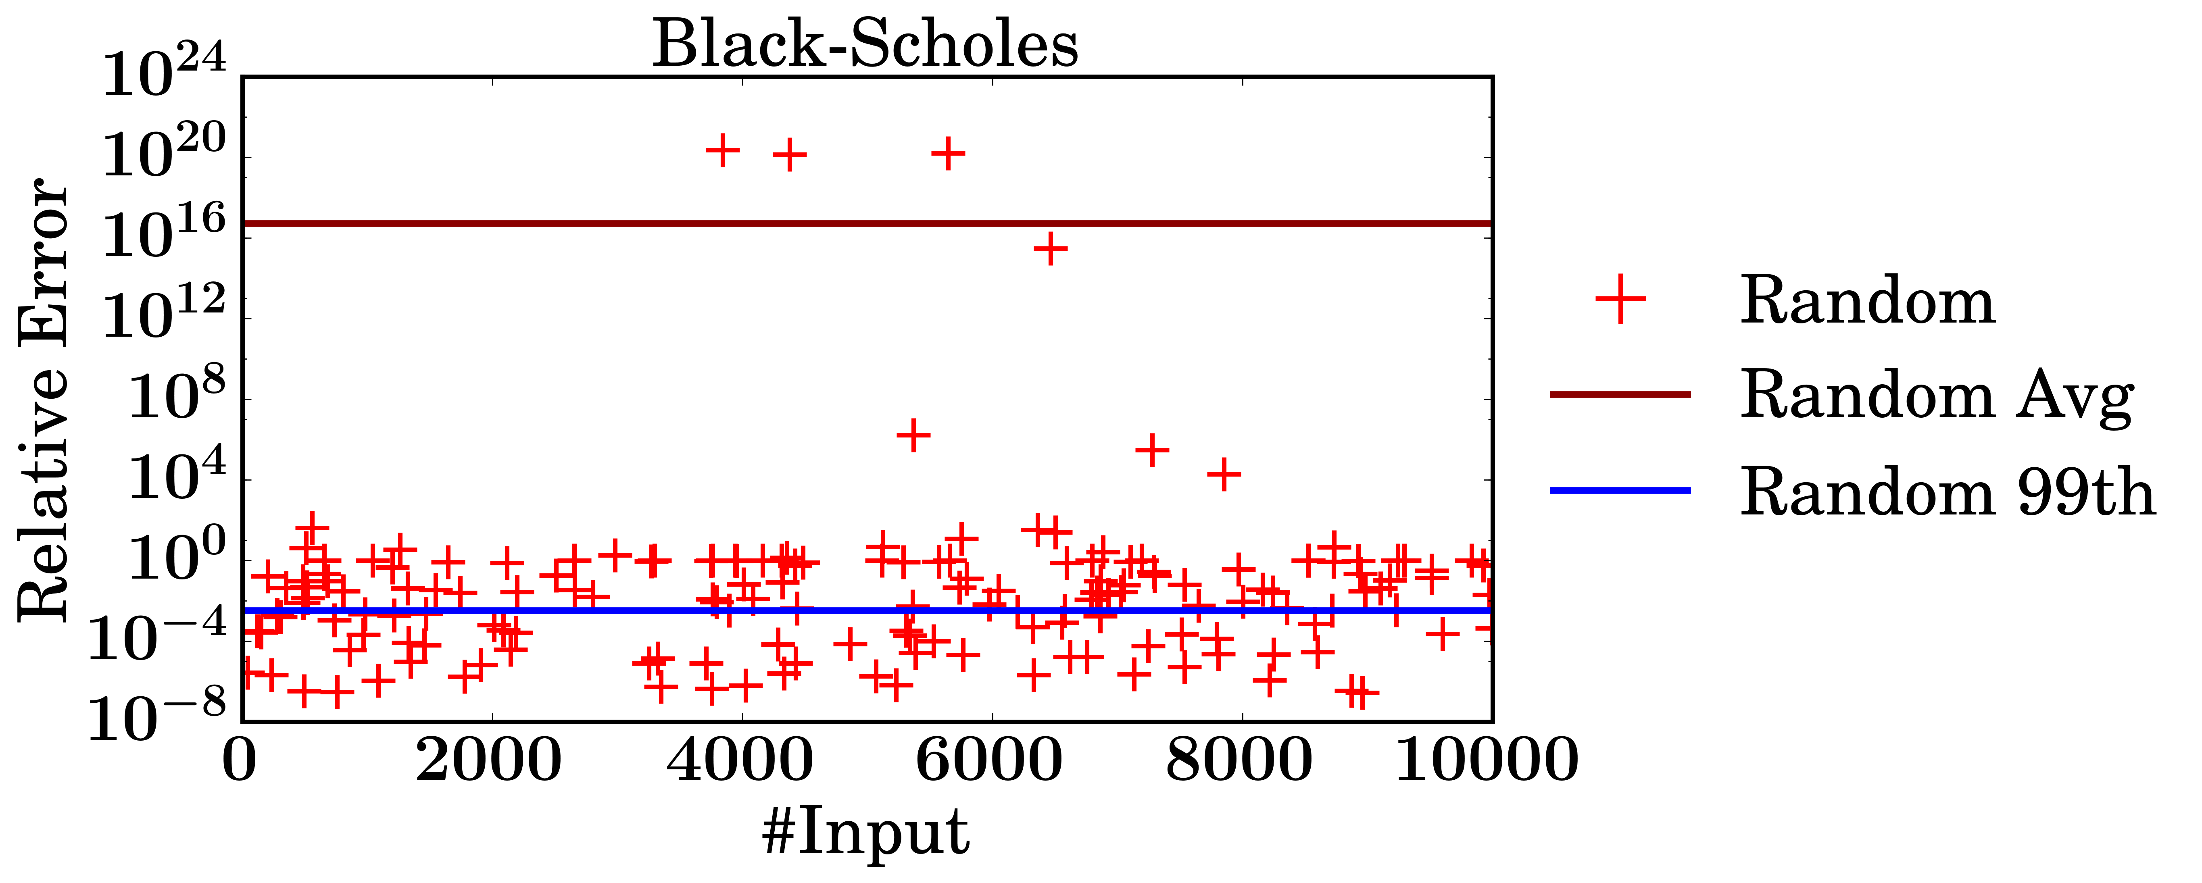
PROBLEM
CHALLENGE OF APPROXIMATE MEMORY
Outliers
10²⁰
Errors in different outputs can have high deviation
Statistical guarantee does not prevent outliers

Slide 9
BACKGROUND
PROBLEM
GOAL
Provide a worst-case guarantee on
the output error of approximate programs
CHALLENGES AND SOLUTIONS
ARMOR

Slide 10


KEY IDEAS
PROVIDING RESTRICTED APPROXIMATION
1. Restrict error in input approximate variables
2. Analyze error due to operations in program
A
+
B
Input Error
Restricted
Worst-Case
Guarantee
INPUT
OUTPUT
Worst-case guarantee on output error

Slide 11
BACKGROUND
PROBLEM
GOAL
CHALLENGES AND SOLUTIONS
ARMOR

Slide 12
Challenge I:
How to restrict the maximum error in approximate variables?

Slide 13
SOLUTION I
RESHUFFLE FAILURES TO LOW-ORDER BYTES
MSB
LSB
Approximate Memory
S
Exponent
Mantissa
Reshuffle
Reshuffle in
Memory Controller
S
Exponent
Mantissa
Cache
S
Exponent
Mantissa
Precise
Restricted
Error
Restrict max error in input approximate variable to 3.04×${10}^{−5}$
Max Base Error
Notes:
Add procedure of reshuffle (mem, mc, cache)

Slide 14

Base Error:
Relative error in each approximate input variable due to memory failures
A
+
B
Base Error
Restricted
INPUT
OUTPUT

Slide 15
Challenge II:
How to analyze maximum error
in the program output?

Slide 16
SOLUTION II
ANALYZE MAX ERROR IN OUTPUT
e = c + d
c = a * b
a
Max Propagated Error
c
Max Input Error
b
e
Max Input Error
Max Propagated Error
(final output)
d
The worst-case output error can be statically calculated according to the data flow graph
Max propagated error of e depends on
max propagated error of c and input error of d
Max propagated error of c depends on
max input error of a and b

Slide 17
Propagated Error:
Error that is dependent on the operations
in the program
A
+
B
Base Error
Restricted
Propagated Error
INPUT
OUTPUT

Slide 18
Challenge III:
Can we also restrict data-dependent errors?
0.9
0.99
INPUT
OUTPUT
x =
0.999
1- x
0.9999
0.99999
Different input values

Slide 19
CORNER-CASES
VALUE-DEPENDENT ERRORS
Corner cases
Corner cases
Within worst-case guarantee
A small fraction of values can cause
an error higher than the worst-case guarantee

Slide 20
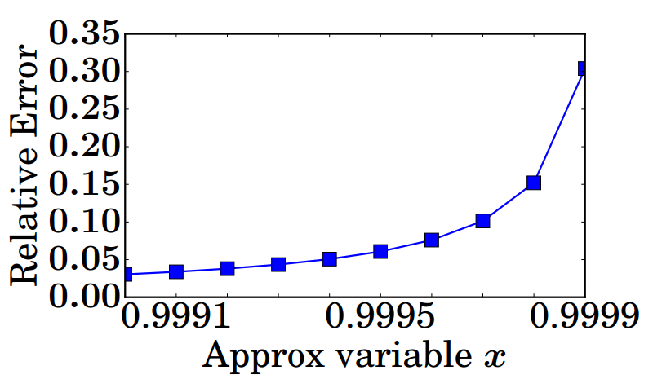
CORNER-CASES
VALUE-DEPENDENT ERRORS
E.g., Floating Point Cancellation:
Subtracting two close floats can cause high error in result
[Goldberg’91]
Relative Error in 1 - x
Error Increase
Error is value-dependent in subtraction
Error can be high if x is close to 1

Slide 21
SOLUTION III
HANDLE CORNER CASES
Step I: Detect potential corner cases at runtime
Detect corner cases
Step II: Re-execute corner cases with precise values
Up to only 0.27% input need re-execution

Slide 22
BACKGROUND
PROBLEM
GOAL
CHALLENGES AND SOLUTIONS
ARMOR
Restrict base error through reshuffling
Analyze worst-case error statically
Detect and re-execute corner-cases

Slide 23
ARMOR
PUTTING EVERYTHING TOGETHER
Approx
Program
Worst-Case
Guarantee
Reshuffling
Static Analysis
Detect &
re-execute
Approximate
Memory
OFFLINE
ONLINE

Slide 24
ARMOR
BENEFIT FROM RESTRICTED APPROXIMATION
Eliminate Outliers
10²⁴ Lower
Expectation-Based Bound
Worst-Case Bound
Worst-case
Expectation-based
Choice of bound depends on
the reliability requirement
ARMOR significantly reduces worst-case error
and improves average error
Notes:
Worst-case assume every input contains error, but actually it is very low

Slide 25
SUMMARY
Randomly distributed failures in approximate memory can cause high error in program output
Provide restricted approximation with a
worst-case guarantee
Restrict base error through reshuffling of failures
Provide a worst-case guarantee by static analysis
Detect and re-execute corner-cases
PROBLEM
GOAL
SOLUTION

Slide 26
ARMOR:
Towards Restricted Approximation with
A Worst-Case Guarantee
Sihang Liu, Kevin Angstadt, Mike Ferdman, and Samira Khan
The concept of restricted approximation can:
Guarantee worst-case error in error-resilient and memory-intensive workloads, e.g., Neural Networks
Provide useful feedback to programmers to further enhance the error-resiliency by improving the algorithm

Slide 27
BACKUP SLIDES

Slide 28
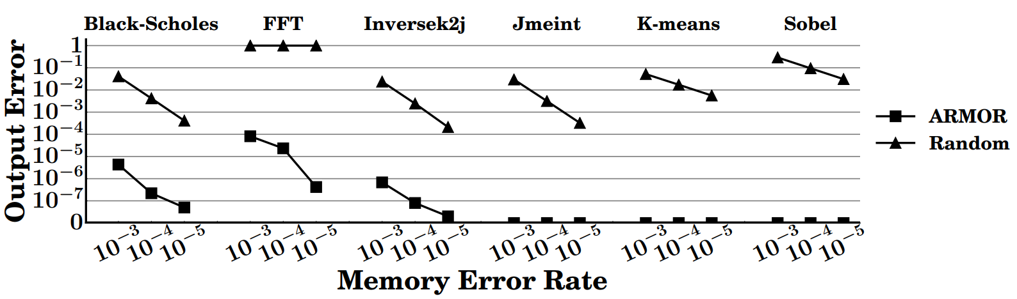
EVALUATION
QUALITY OF ARMOR (W/O RE-EXECUTION)
Error of ARMOR is always orders of magnitudes lower than random error without restriction

Slide 29
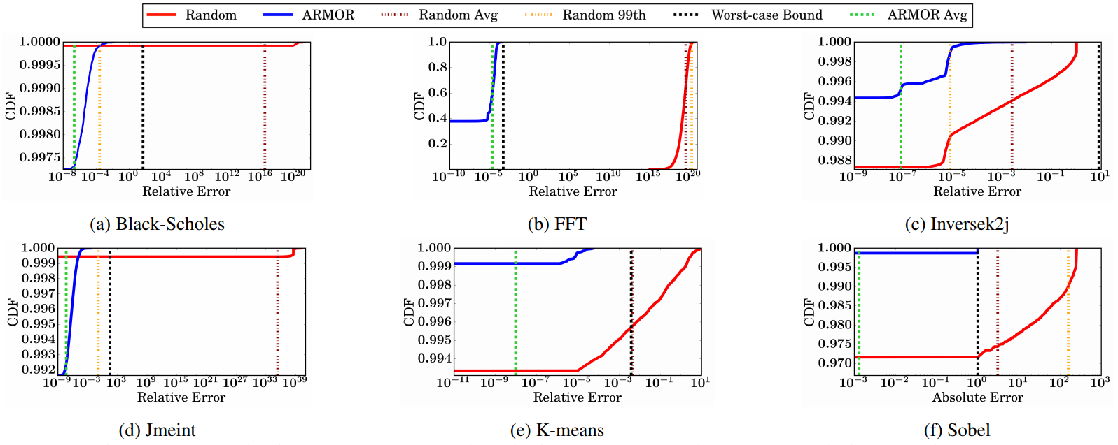
EVALUATION
WORST-CASE GUARANTE FROM ARMOR
31 ~ 40,000X Error Reduction

Slide 30
EVALUATION
PERFORMANCE AND ENERGY
Benefit Increase
Benefit Increase
Significant performance and energy benefit (with reshuffling and re-execution)

Slide 31
BACKGROUND
DRAM SCALING
Density of DRAM cell increase
Refresh Time Increase
[RAIDR’12]
Density
Performance overhead from refreshing increase as density increase

Slide 32
BACKGROUND
DRAM SCALING
Density of DRAM cell increase
Performance overhead increase
DRAM Energy Increase
[RAIDR’12]
Density
Energy overhead from refreshing
increase as density increase

Slide 33
RESHUFFLING
Step I: Detect and track the locations of failing bits
[Liu’12, Nair’13, Liu’13, Kim’14, Khan’14, Qureshi’15, Khan’16, Khan’17, Patel’29]
Memory
Reshuffle
Cache
Step II: Reshuffle byte with error to low-order byte

Slide 34
MAX BASE ERROR
Reshuffle
S
Exponent
Mantissa
Precise
Restricted
Error
$$\text{max}\text{_}\text{relative}\text{_}\text{error} \text{=}\frac{\text{|}\text{approx}\text{_}\text{value} – \text{original}\text{_}\text{value}\text{|}}{\text{original}\text{_}\text{value}}$$
= $\frac{\text{|}\text{approx}\text{_}\text{mantissa} – \text{original}\text{_}\text{mantissa}\text{|}}{\text{original}\text{_}\text{mantissa}}$
= $\frac{ 255}{2^{23}}$
≃ 3.04×${10}^{−5}$

Slide 35
Error in Operations
Operation | Example | Propagation
Load/Store | a = b | err_{b}
Mult/Div | a = b */ c | err_{b}+err_{c}
Add/Sub | a = b ± c | n|max{err_{b}, err_{c}}|
Note: n depends on the threshold in corner case detection
Error higher than n times will be re-executed

Slide 36
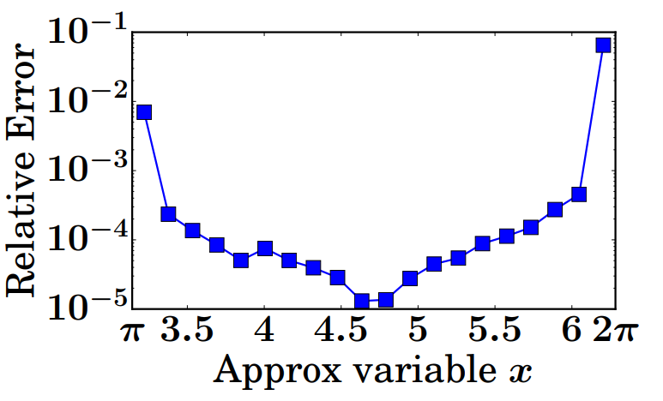
CORNER-CASES
HIGH ERROR DUE TO OPERATIONS
1. Floating Point Cancellation:
Subtracting two close floats can cause high error in result
[Goldberg’91]
2. Math Functions:
Certain input to some math functions can cause high error
Relative Error in 1 - x
Relative Error in sin(x)
Error Increase
Error Increase
Error Increase
Error is value-dependent
Error can be high if x is close to multiple of $π$
Error can be high if x is close to 1

Slide 37
SOLUTION III
HANDLE CORNER CASES
Step I: Detect potential corner cases at runtime
[Lam’13]
For operation a = b – c,
difference of exponent between input and result is:
diff = max (exp_{b}, exp_{c}) – exp_{a}
error
diff
Step II: Re-execute corner cases with precise values
Independent Inputs
1
2
3
4
5
Re-execute
4
Corner case detected

Slide 38
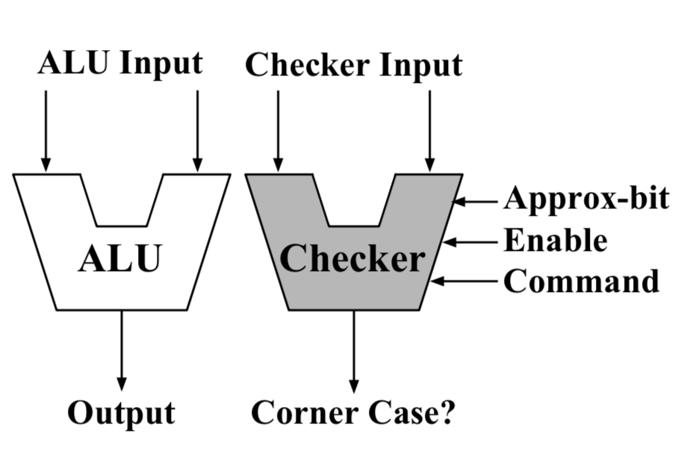
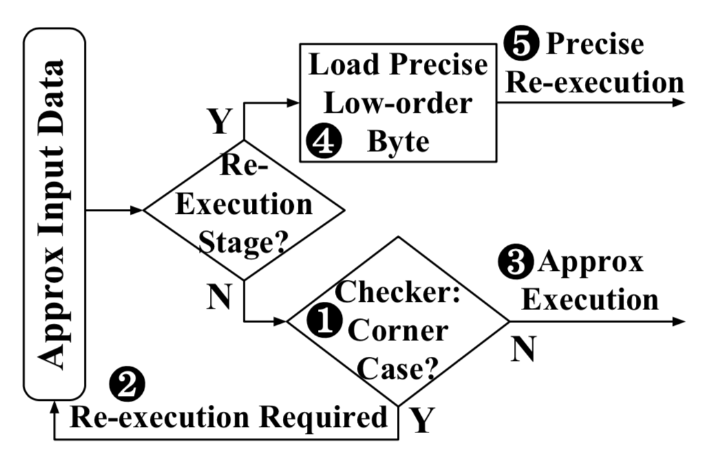
RE-EXECUTION MECHANISM
Hardware checker for corner case detection
Flow diagram for
detection and re-execution

