Slide 1
PMNet In-Network Data Persistence
Korakit Seemakhupt, Sihang Liu, Yasas Senevirathne Muhammad Shahbaz, Samira Khan
Artifact available at pmnet.persistentmemory.org
Notes:
Hi, I am Korakit Seemakhupt.
I am going to talk about our work PMNet; A system that accelerates update request by persistently stores data in network.
This work has been done with our collaborators Sihang Liu, Yasas Senevirathne and Samira Khan from University of Virginia and Muhammad Shahbaz while he was at Stanford.

Slide 2
Summary
Motivation
Datacenter applications usually store data in separate servers and manage through network
Long latency of update requests slows down clients
In-network compute reduces read requests’ latency but not update requests
Key Insight
Maintain persistent states in network devices by adding persistent memory
Persist update requests in network to move server’s latency off the critical path
PMNet
Logs requests in network device's persistent memory
Recovers server using logged requests in case of a failure
Integrates in-network data persistence with data replication and caching
Evaluation
End-to-end FPGA implementation of PMNet-enabled NIC and switch
Improves throughput by 4.27x and tail latency by 3.23x over client-server baseline
Notes:
For the summary of this talk, we start with an observation that
Data center application usually store data in separate storage servers and manage the data through network
Update request’s latency slows down the client and
In-network compute reduces read requests’ latency but not update requests
Our insight are 1. Maintain persistent state in network by adding PM to network device
2. Persist update request in network to move server off the critical path
We propose PMNet that logs request in PM in the network and use logged requests in order to recover from failure
We also integrate PMNet with replication and read caching.
We implement PMNet on FPGA and evaluate whole system.
The result shows that PMNet improve both throughput and tail latency over client-server baseline.

Slide 3
Outline
Background and Motivation
In-network Data Persistence
PMNet Design
Caching and Replication
Evaluation
Conclusion
Notes:
First, I will talk about the Motivation of PMNet.

Slide 4
Storage Applications in Datacenter
Common datacenter applications store data in separate storage servers
Memcached
MariaDB
Redis
Social networking
Online Transaction Processing
Network
Client Applications
Storage Servers
Latency of accessing data on the storage server is critical to the performance of those applications
Notes:
Common applications in datacenter stores data in separate storage server.
For example, the front end of the social networking and Online transaction processing such as banking application access storage backend such as Memcached and Redis.
The latency of accessing data in the storage server is critical to the performance of these applications.

Slide 5
Storage Applications in Datacenter
Network
Client Applications
Storage Servers
A transfers $10 to B
Notes:
For example, in this banking application, A wants to pay B 10 dollar

Slide 6
Storage Applications in Datacenter
Request
Network
Request
Client Applications
Storage Servers
A transfers $10 to B
A’s balance - 10
B’s balance + 10
Notes:
The banking application sends the request to update the balance of A and B on the storage server.
During which the application waits for the server to respond in order to ensure that the server processes and persists the update.
#Should I use the work front-end?

Slide 7
Storage Applications in Datacenter
Response
Network
Response
Client Applications
Storage Servers
A transfers $10 to B
B receives $10 from A
A’s balance - 10
B’s balance + 10
Update requests can be latency-critical​
Notes:
Only after the server responds, the client continues with the next operations.
Therefore, update requests are latency critical.

Slide 8
Latency of Accessing a Data Store
Client’s progress
Client
Network
Server
Request
9.6%
20.3%
30.6%
39.6%
Process
Response
Processing
Network Stack
Network Stack
Processing
Client
Server
Notes:
Now we want to see the source of this latency.
Here is what happen when the client sends the request.
The request is forwarded through network stack of the client, through the network and enters the network stack of the server.
Then the request is processed by the server and the server sends the response to the client.
//check animation

Slide 9
Latency of Accessing a Data Store
Client’s progress
Client
Network
Server
Request
9.6%
20.3%
30.6%
39.6%
Process
Response
Processing
Network Stack
Network Stack
Processing
Client
Server
Observation : Majority of the latency is spent on the server side
Notes:
The breakdown of update request latency shows that 70% of the round trip latency is from server side’s network stack and processing.
Therefore, latency on the server side is a bottleneck.

Slide 10
Existing Approaches
Client
In-network compute and cache
Server
In-network compute [Brainwave NPU ISCA’18, iSwitch ISCA’19, E3 ATC’19, iPipe SIGCOMM’19]
Add compute logic to network devices, such as switches and NICs
Reduce RTT of compute tasks
In-network data caching [NetCache SOSP’17, Incbricks SOSP’17, DistCache FAST’19]
Add volatile cache in network devices
Reduce RTT of GET requests
Notes:
However, there are existing approaches that mitigates the server sided latency.
First is in-network compute.
In network compute adds application logic in network device.
It reduce the latency of compute tasks.
Another way to reduce latency is by caching data in-network.
In network data caching adds volatile cache in network devices.
It reduces latency of read request. Here is how.

Slide 11
In-network caching: Read Requests
Client’s progress
Client
In-network cache
Server
GET (x)
Request
Look up x
Hit
Miss
Response
Forward
x=1
Some Read requests can be served faster from the network device
Notes:
For in-network cache, the client sends the request to the server.
When the request arrives at an in-network cache, the cache looks up for an entry in the memory.
In a case where the cache hits, the in-network cache responds the read request, thus, removing the server from the critical path of that request.
In a case where the cache misses, the request is forwarded to the server.
Therefore, some read request can be served faster in the network device.

Slide 12
In-network caching: Update Requests
Client’s progress
Client
In-network cache
Server
SET (x, 1)
Request
Failure
SET (x, 1)
Request
Process
ACK
Response
In-network caching has no persistent storage and cannot serve update requests
Notes:
However, because failure can happen while the request is being delivered to the server,
for the update request, the client waits until it receives the response directly because it needs to ensure that the request is persistently stored on the server.
Thus, in-network caching lacks persistent storage and cannot move update request latency off the critical path

Slide 13
Outline
Background and Motivation
In-network Data Persistence
PMNet Design
Caching and Replication
Evaluation
Conclusion
Notes:
Next I will talk about the Key idea of PMNet.

Slide 14
Our proposal: In-network Data Persistence
Add Persistent memory to network device
Client
PMNet
Server
Add persistent memory to log update requests
Notes:
To reduce the blocking time of update requests, PMNet adds persistent memory to network devices.
Persistent memory allows PMNet to persistently log update requests.

Slide 15
Key idea : Persistent logging
1
Log request
Send ACK to unblock the client as soon as the update request persists
Forward the request to the server
2
3
Client’s progress
Client
PMNet
Server
SET (x, 1)
3
Request
Off the critical path
Request
Sub-RTT
Log
RTT
1
ACK
Process
2
Response
Response
PMNet enables sub-RTT data persistence in the network
Notes:
Here is how PMNet’s persistent logging works.
Upon receiving update request from the client, PMNet logs the request in the persistent memory.
After the request persists in the memory, PMNet sends ACK to immediately unblock the client.
Then, PMNet forwards the update request to the server, the server then process the request off the critical path.
Therefore, PMNet enables sub-RTT data persistence in the network.
/Fix animation

Slide 16
Persistent logging Challenges
How to recover lost packets?
In-flight requests can be lost due to a crash
Request
Crash
Notes:
However, there are challenges for persistent logging.
First is how to recover lost packet when failure happens.

Slide 17
Challenge: System recovery
Failure
Client’s progress
Client
PMNet
Server
Set (x, 1)
Request
Failure
Request
Log
ACK
Response
The client receives ACK and cannot resend the request
Notes:
For example, after the client sends the update request, PMNet logs the update request and sends the ACK to unblock the client.
Then a failure happens while the request is being forwarded to the server.
Since, the client is already received an ACK and proceeds to the next operation, it cannot resend the request.

Slide 18
Solution: Recover from Persistent Logs
1
Server sends Retrans
PMNet looks up logged update request
PMNet resends logged request to the server
2
Heartbeat
3
Recovery
Client’s progress
Client
PMNet
Server
Retrans
Look up
Resend
Process
PMNet recovers lost requests from persistent logs
Notes:
In order to recover a missing request,
First, the server detects a failure using a timeout or a heartbeat signal.
Then, the server sends Retransmit request to PMNet.
PMNet reads logged update request in PM and resends it to the server.
The server then processes the request normally.
Therefore, PMNet recovers lost requests from persistent logs.
//Add heartbeat
//Fix animation

Slide 19
Persistent logging Challenges
How to recover lost packets?
In-flight requests can be lost due to a crash
Request
Crash
How to ensure correct ordering?
Requests from the same client can be reordered in the network
1
2
2
1
Request
Request
Single-Client Reordering
Notes:
Next challenge is how PMNet ensure that the requests are executed in the server in correct order.
First, I will talk about requests from the same client.

Slide 20
Challenge : Request reordering
Single client ordering
A
B
Request
Client
PMNet
Server
Notes:
For example, when a client sends two requests.

Slide 21
Challenge : Request reordering
Single client ordering
Packet reordered in network
B
A
Request
Request
Client
PMNet
Server
Notes:
The request can be reordered in the network

Slide 22
Solution: Single-client Ordering
Single client ordering
Add SeqNum
SeqNum=2
B
SeqNum=1
A
Request
Request
Client
PMNet
Server
Notes:
To maintain the ordering from the same client, PMNet client adds a sequence number to each PMNet packet.

Slide 23
Solution: Single-client Ordering
Single client ordering
Fix order
SeqNum=1
A
SeqNum=2
B
Request
Request
Client
PMNet
Server
The server corrects order based on Sequence Number in each packet
Notes:
The server can then use the sequence number to correct the order and process the request in-order.
//Fix style.

Slide 24
Persistent logging Challenges
How to recover lost packets?
In-flight requests can be lost due to a crash
Request
Crash
How to ensure correct ordering?
Requests from the same client can be reordered in the network
Requests from multiple clients can become out of order
1
2
1
1
2
2
1
Request
Request
Request
Request
Request
Single-Client Reordering
2
Multi-Client Reordering
Notes:
Another issue with ordering is ordering across multiple clients.

Slide 25
Challenge : Request reordering
Multi client ordering
Client 1
PMNet
Server
Client 2
1:lock
Time
Client 1
Client 2
2:lock
1
2
3
4
lock()
tasks()
unlock()
lock()
tasks()
unlock()
Notes:
For example, when two clients want to update a critical section.
First, both clients sends a lock request to acquire a shared lock on the server.

Slide 26
Challenge : Request reordering
Multi client ordering
Client 1
PMNet
Server
Client 2
1:lock
Time
Client 1
Client 2
2:lock
1
2
3
4
lock()
tasks()
unlock()
lock()
tasks()
unlock()
1:ACK
2:ACK
Both clients receive ACKs from PMNet
Notes:
However, the lock requests persist in PMNet and PMNet sends ACK to respond the clients.

Slide 27
Challenge : Request reordering
Multi client ordering
Client 1
PMNet
Server
Client 2
1:lock
Time
Client 1
Client 2
2:lock
1
2
3
4
lock()
tasks()
unlock()
lock()
tasks()
unlock()
1:ACK
2:ACK
1:tasks
Both clients enter the critical section
2:tasks
Notes:
After both clients received the ACK, both clients enter the critical section.
This is wrong because only one client can enter the critical section.

Slide 28
Solution: Multi-client Ordering
PMNet bypasses synchronization primitives to ensure single client enters the critical section
Updates in the critical section are still logged in PMNet
Client 1
PMNet
Server
Client 2
1:lock
Time
Client 1
Client 2
1
2
3
4
lock()
tasks()
unlock()
lock()
tasks()
unlock()
2:lock
1:lock acquired
2:lock rejected
Only client 1 can enter the critical section
1:tasks
1:ACK
Bypass requests are infrequent: 13.7% in TPC-C
Notes:
To solve this problem, synchronization primitives such as lock requests bypass PMNet.
In this case, lock requests is forwarded and processed on the server.
Therefore, only one client acquires the lock and enters the critical section.
Note that even though lock requests cannot benefit from persistent logging, update requests within the critical section can still benefit from shorter latency.
AND, the bypass requests are not frequently used.
// Fix text, steps

Slide 29
Outline
Background and Motivation
In-network Data Persistence
PMNet Design
Caching and Replication
Evaluation
Conclusion
Notes:
Next we talk about PMNet design. How PMNet enables in-network persistent logging.

Slide 30
PMNet overview
PMNet pipeline: How does PMNet’s hardware enable persistent logging?
PMNet protocol: How are PMNet packets defined?
MAT Pipeline
Client
Server
PM
PMNet
PMNet packet
Eth
IP
UDP
Type
Session ID
SeqNum
HashAddr
PMNet headers
Notes:
For the design, I will talk about two parts:
First, the PMNet hardware pipeline: how PMNet hardware enables persistent logging in network device?
Second, PMNet protocol, how PMNet’s packets are defined,

Slide 31
Baseline NIC/Switch Architecture
Baseline NIC and switch forward packet with rules in Match-action table (MAT) pipeline
Interface
MAT Pipeline
Interface
Forward
Client
Server
Baseline NIC and switch forwards packet to the destination
Notes:
For traditional programmable switch or NIC, the packets are forwarded to the destination according to rules programmed in the Match-action table or MAT.
Fix the style.

Slide 32
PMNet NIC/Switch Architecture
PMNet NIC and switch’s MAT pipeline process PMNet packet in addition to other packets
Interface
MAT Pipeline
Interface
Client
Server
Log queues
Store logged requests
Log queue isolates PM’s latency from MAT pipeline
PM
Update logs
PMNet MAT Pipeline controls access to the persistent memory
Notes:
On the other hands, PMNet NIC or switch add
Log queue that buffers requests from the MAT pipeline to the persistent memory and the persistent memory stores the logged request.
Thus, in addition to forwarding incoming packets, PMNet’s MAT pipeline controls access to the persistent memory.

Slide 33
PMNet Design: Protocol
Defines four packet types on top of UDP
Type
Action
UDP
PMNet headers
Update
Log+forward request, send ACK
ACK
Remove log and unblock client
Type
SeqNum
SessionID
HashVal
Retrans
Resend logged entry
Bypass
Forward request
PMNet performs different operation based on packet type
Notes:
For PMNet protocol, PMNet is built on top of UDP protocol by reserving a specific UDP port.
PMNet header consists of 4 fields, Type that determines different PMNet packet types , Session ID that is used to separate different PMNet session, Sequence number that is used for ordering and Hashvalue that is used to index the request.
PMNet device performs different operation based on type field the defines the packet type.
We will see how PMNet handles each type of packet.
//Talk about each field
//Talk about

Slide 34
PMNet packet processing: Update requests
1
Log update request
Send ACK to client
Forward request to the server
2
3
3
Forward request to the server
Requests
Forward
Interface
MAT Pipeline
Interface
Request
Client
ACK
ACK
2
Send ACK
Server
Update
Log queues
Log
ACK
Types of packet
1
Log request
Retrans
PM
Update logs
Bypass
PMNet logs and forwards update requests and sends ACK to unblock client
Notes:
For the update request, PMNet first logs the update request in the persistent memory.
After the request persists, PMNet sends ACK to unblock the client.
And at the same time, PMNet forwards the request to the server.
Therefore, PMNet logs and forwards update requests, and PMNet sends ACK to unblock the client once the request persists.

Slide 35
PMNet packet processing: ACK
1
Remove logged request
Forward ACK to the client
2
2
Forward ACK to the client
Interface
MAT Pipeline
Interface
ACK
Forward
ACK
Client
Server
Update
Log queues
Remove
ACK
Types of packet
1
Remove log
Retrans
PM
Update logs
Bypass
PMNet ACK removes the logged entry
Notes:
For the ACK packet, PMNet removes an associated log entry in PM.
AND PMNet forwards ACK to the client.
Fix this.

Slide 36
PMNet packet processing: Retrans
1
Look up logged request
Read logged request
Resend request to the server
2
3
3
Resend the request to the server
Interface
MAT Pipeline
Interface
Retrans
Resend
Request
Client
Server
Update
Log queues
Look up
Read
2
ACK
Read logged request
Types of packet
1
Look up request
Retrans
PM
Update logs
Bypass
PMNet Retrans resends the logged entry
Notes:
For a retrans request that the server sends when the server is recovering a missing packet, PMNet looks up logged request, read logged request and resend the request to the server.

Slide 37
PMNet packet processing: Bypass
1
Forward the request
1
Forward the request to the server
Interface
MAT Pipeline
Interface
Bypass
Forward
Bypass
Client
Server
Update
Log queues
ACK
Types of packet
Retrans
PM
Update logs
Bypass
PMNet forwards Bypass packets
Notes:
For bypass packet such as synchronization primitives, PMNet forwards the request directly to the server.

Slide 38
PMNet design
PMNet logs update requests to move the server off the critical path
Applications of PMNet:
Request
Response
Replication
Caching
Notes:
So far, we have talked about how PMNet enables persistent logging in network device to accelerate update request.
Next, I will talk about additional applications of persistent logging that is
Accelerating Replication and
Using logged request as read cache.

Slide 39
Outline
Background and Motivation
In-network Data Persistence
PMNet Design
Caching and Replication
Evaluation
Conclusion
Notes:
Next, I will talk about PMNet’s integration of read caching and replication.

Slide 40
PMNet Replication : Baseline replication
1
Replicate request to all servers
Process the request
Wait until all servers respond
2
3
Client’s progress
Client
Network
Primary
Replica
Request
1
Replicate
2
Process
Process
2
3
Wait
ACK
Response
Notes:
For replicated server without PMNet, we use an example of simple primary-backup servers, which when the primary receives an update request,
it replicates the requests across all replicas.
The servers then process the request.
Only after all replicas finished processing the request, the primary sends a response to the client.
>> next slide

Slide 41
PMNet Replication : Baseline replication
1
Replicate request to all servers
Process the request
Wait until all servers respond
2
3
Client’s progress
Client
Network
Primary
Replica
Request
1
Replicate
2
No replication
Process
With replication
2
Process
Response
Wait
ACK
3
Response
Replication increases blocking latency
Notes:
We can see that; replication increases the latency of an update request.

Slide 42
PMNet Replication : Replication with PMNet
Two PMNet
Two Servers
Client’s progress
Client
PMNet #1
PMNet #2
Primary
Replica
Notes:
In order to accelerate replication, PMNet logs update requests in multiple devices to protect against hardware failure.
In this example with two-way replication on the server, the update requests are also logge in two PMNet devices
>> NEXT SLIDE

Slide 43
PMNet Replication : Replication with PMNet
1
The client sends the request and waits for 2 ACKs
PMNet #1 and #2 log the request and send ACK to the client
Client waits until it receives both ACKs
2
3
Client’s progress
Client
PMNet #1
PMNet #2
Primary
Replica
1
Request
Request
Request
Replicate
2
Log
2
Log
Process
ACK
Process
3
ACK
Wait
ACK
Response
Notes:
when the client sends an update request, the request is also logged in both PMNet devices. Note that, logging in PMNet devices happens in parallel.
However, instead of immediately proceeding to the next operation upon receiving a single ACK,
the client waits for the ACK from both PMNet. Thus, ensure that the request persists in two PMNet devices.
Then the request is forwarded to the replicated server, off the critical path.

Slide 44
PMNet Replication : Replication with PMNet
1
The client sends the request and waits for 2 ACKs
PMNet #1 and #2 log the request and send ACK to the client
Client waits until it receives both ACKs
2
3
Client’s progress
Client
PMNet #1
PMNet #2
Primary
Replica
1
Request
Request
Request
Replicate
2
Log
2
With replication
Log
Process
PMNet+replication
ACK
Process
3
ACK
Wait
ACK
Response
PMNet moves replication off the critical path with the same level of protection
Notes:
We can see that, PMNet moves the latency of replication off the critical path, while offering the same level of protection against hardware failure as on the server.

Slide 45
In-network caching: Update Requests
1
PMNet logs update requests
Client’s progress
Client
PMNet+cache
Server
SET (x, 1)
Request
Request
Log
1
ACK
Notes:
For the integration of read cache, PMNet exploits logged request in the PM to accelerate read requests.
First, PMNet logs incoming update request, sends ACK to unblock the client and forward the request to the server.
//fix bl

Slide 46
In-network caching: Read Requests
1
PMNet logs update requests
PMNet receives read request and looks up an associated logged request in the PM
PMNet responds the read request (Hit) or forward the request (Miss)
2
3
Client’s progress
Client
PMNet+cache
Server
GET (x)
Request
2
Look up x
x=1
Request
3
Response
3
Miss
Hit
PMNet can use logged entry to respond read requests.
Notes:
Upon receiving the read request, PMNet lookups for an associated entry in PM.
If the look up is a hit, PMNet uses logged request to respond the read request.
Otherwise, PMNet forwards read request to the server.
Thus, PMNet uses logged update requests to respond read request.

Slide 47
Outline
Background and Motivation
In-network Data Persistence
PMNet Design
Caching and Replication
Evaluation
Conclusion
Notes:
Next, I will talk about the evaluation of PMNet.

Slide 48
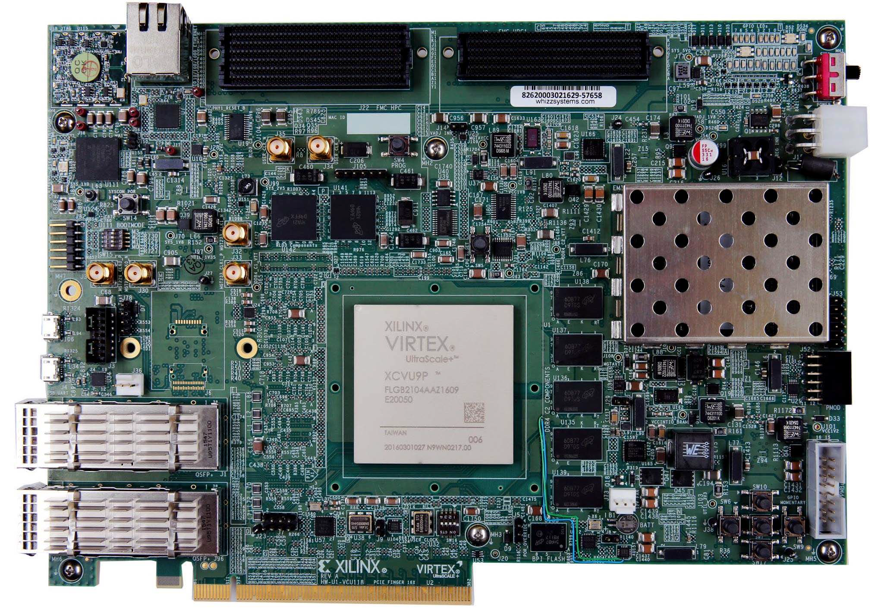
Methodology
Hardware
PMNet
Server
Client
Xilinx VCU118 Evaluation platform
Intel Cascade Lake, 20 Cores, 192GB DRAM, 256GB DCPMM
Intel Haswell, 6 Cores, 64GB DRAM
1
MAT Pipeline
Emulated Persistent memory
Network interfaces
2
2
1
3
3
PMNet evaluation platform
Notes:
We implement PMNet on Xilinx’s Virtex Ultrascale + evaluation platform.
We program MAT pipeline on the FPGA.
We use DRAM to emulate the persistent memory and we use QSFP ports as network interefaces.
We run the network interface at 10Gbit/s because we adapt NetFPGA SUME design to our evaluation platform.

Slide 49
Methodology
Design points
PMNet-Switch: PMNet as a bump-in-the-wire in the TOR switch of server rack
PMNet-NIC: PMNet as a bump-in-the-wire in the server’s NIC
PMNet-NIC
PMNet-Switch
Notes:
For the design point, we implement PMNet both as a bump-in-a-wire in Server’s NIC and as a bump-in-a-wire in Server rack’s ToR switch.

Slide 50
Results
Update request Bandwidth vs. Latency
Notes:
For the first experiment, we want to see the performance of PMNet device, we use an ideal handler on the server that immediately responds the request.
The graph here shows bandwidth and latency of update requests.
The Y axis shows latency and X axis shows the bandwidth.
The red line shows the latency and bandwidth of baseline Client-server setup.
We can see that the client-server baseline achieve maximum bandwidth of around 10 Gbit/s which is close to 10Gbit/s line rate.

Slide 51
Results
Update request Bandwidth vs. Latency
Notes:
While Blue line shows latency-bandwidth of PMNet in switch setup.
We can see that, with PMNet in ToR switch, the maximum bandwidth is the same but with considerably lower latency.

Slide 52
Results
Update request Bandwidth vs. Latency
Same bandwidth
Lower latency
Both PMNet-Switch and PMNet-NIC provide lower update latency and
same bandwidth as the baseline.
Notes:
While the dashed line shows PMNet in NIC which has similar performance to PMNet in Switch.
Therefore, both PMNet in Switch and PMNet in NIC offer the same benefit of lower latency and same bandwidth as the client-server baseline.
We refer to PMNet in switch only as PMNet for later results.

Slide 53
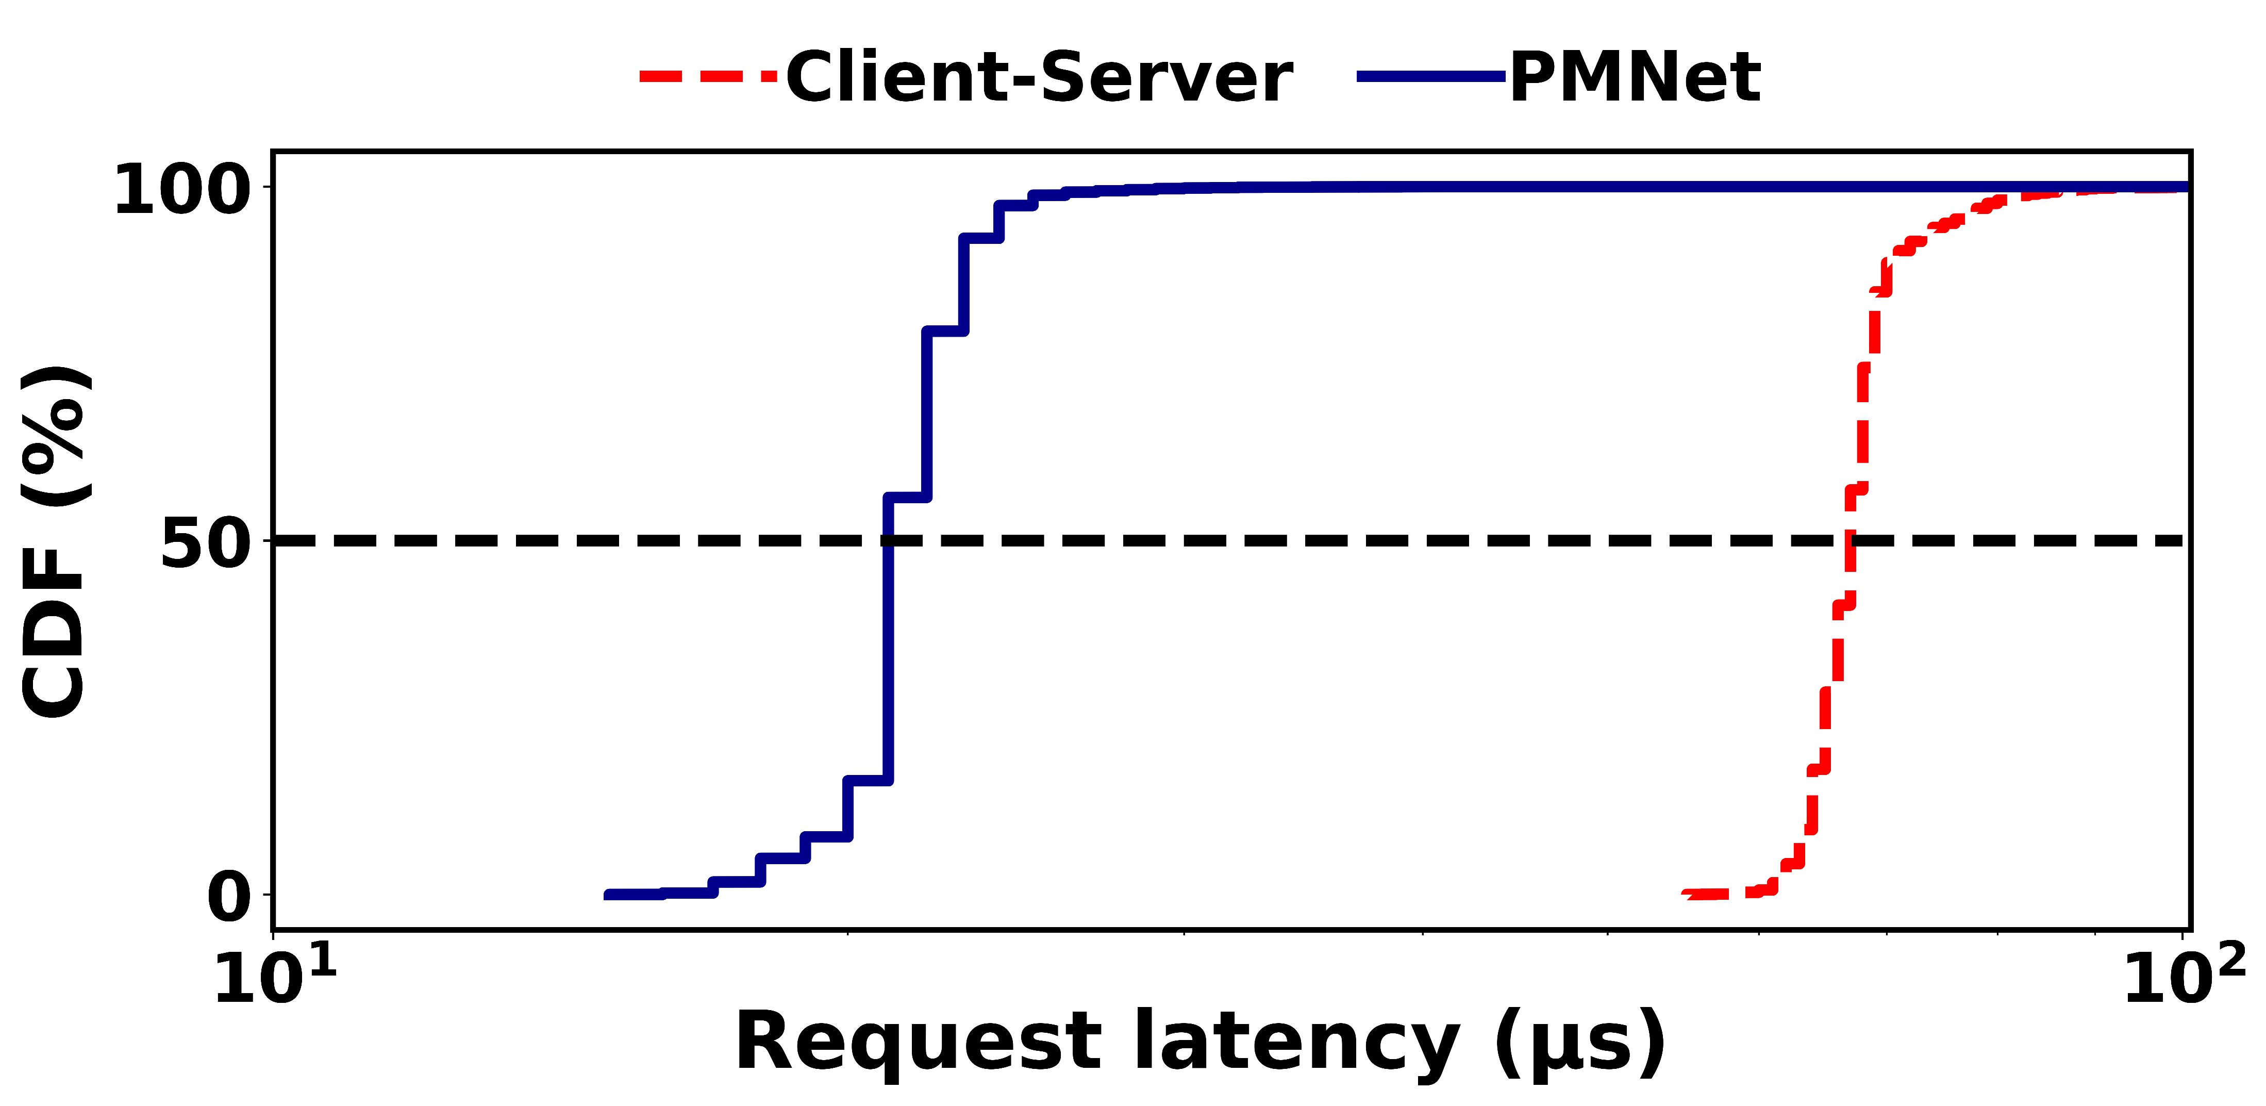
Results
Tail latency: 100% Update requests
Redis
4.5X
PMNet significantly improves 99% tail-latency of update requests
Notes:
Next, we evaluate the update request’s performance of the real application.
This graph shows the latency distribution of the update request in Redis.
X-axis shows the latency of the request. and
Y-axis shows the CDF of the request.
Red line shows the latency of baseline client-server setup and blue line shows the latenct of PMNet setup.
We show Redis workload as an example due to space limitation. Other workloads follow a similar trend.
We can see that for Redis workload, PMNet decreases tail latency of update request by 4.5X.
THerefore, PMNet significantly improves tail lantency of the update requests.

Slide 54
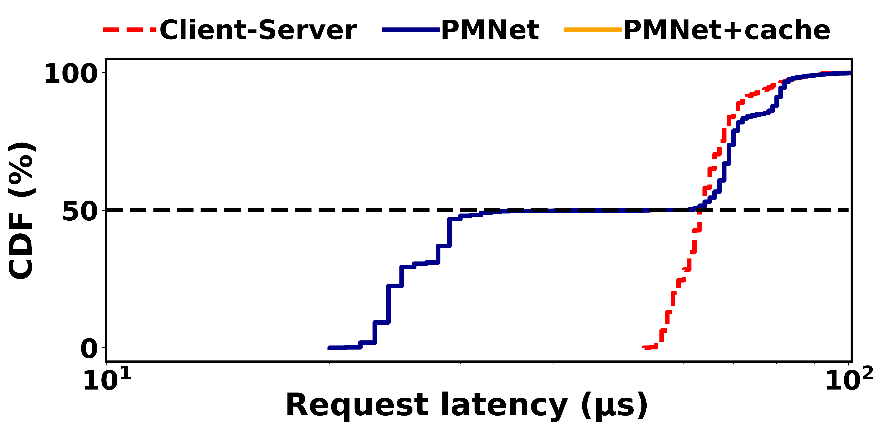
Results
Tail latency: 50%-50% Update-read requests & Cache
Redis
2.5X
Without read cache, PMNet only improves update requests’ latency.
Notes:
Similarly, we evaluate the performance of mixed read and update requests in 50-50 percent ratio.
We can see that while half of the requests which are update requests are accelerated by PMNet.
Read request performance remain the same.
Thus, PMNet without read caching only improves read performance.

Slide 55
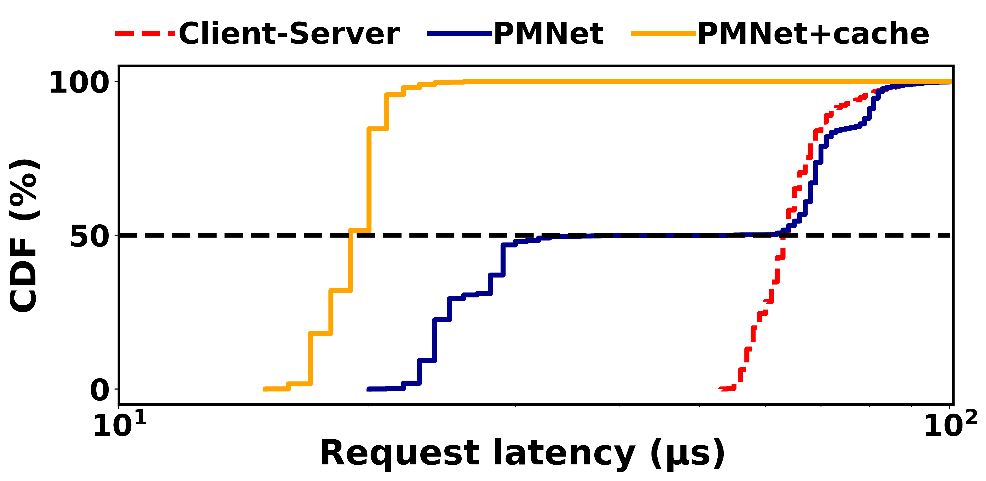
Results
Tail latency: 50%-50% Update-read requests & Cache
Redis
4.3X
With read cache, PMNet improves both read and update requests’ latency.
Notes:
On the other hands, with caching shown in a yellow line, PMNet improves performance of both read and update requests.

Slide 56
Results
3-way Server Replication (R=3)
5.9X
PMNet replication reduces replication latency while offering the same level of protection.
Notes:
For replication, we compare the performance of Baseline client-server with and without replication with PMNet with replication both in PMNet and on the server and and PMNet without replication.
This graph show the latency of update request normalized to client-server baseline without replication on the Y-axis.
The result shows that PMNet with replication reduce the update request latency by 5.9X over client-server with replication. AND the performance penalty of PMNet Replication over PMNet without replication is minor.
Therefore, PMNet moves replication latency off the critical path while maintaining protection against hardware failure.’’
For more details, you can see the full result in the paper.

Slide 57
Outline
Background and Motivation
In-network Data Persistence
PMNet Design
Caching and Replication
Evaluation
Conclusion
Notes:
Next is the conclusion.

Slide 58
Summary
PMNet
Logs requests in network device's persistent memory
Recovers server using logged requests in case of a failure
Integrates in-network data persistence with data replication and caching
Evaluation
End-to-end FPGA implementation of PMNet-enabled NIC and switch
Improves update throughput by 4.27x and tail latency by 3.23x over client-server baseline
Improves 3-way replication (R=3) latency by 5.9X on average
Improves 50-50% read-write latency by 3.36X with read caching on average
Update
Off the critical path
Early ACK
Update
Client
PMNet
Server
Artifact available at pmnet.persistentmemory.org
Notes:
For conclusion,
PMNet logs update request persistently in network device to move server off the critical path and uses logged requests to recover from failure.
PMNet can also integrate with replication and read caching.
We implement PMNet on an FPGA and evaluate whole system.
PMNet improves update throughput by 4.2X and tail latency by 3.2X on average over client-server baseline.
PMNet with replication improves replication latency by 5.9X on average with the same level of hardware failure protection and
With integration of read caching PMNet improves the mixed read-update latency by 3.36X on average.
We also make the implementation of PMNet publicly available in the link here.

