Slide 1

Side Channel Attacks in
Computation Offloading Systems with GPU Virtualization
Sihang Liu, Yizhou Wei, Jianfeng Chi, Faysal Hossain Shezan, Yuan Tian
University of Virginia

Slide 2


Summary
GPUs have been widely adopted in the cloud to process offloaded tasks from mobile and IoT devices
However, sharing the GPU has potential security concerns
The recent GPU virtualization support eliminates existing attacks
This work shows that even with GPU virtualization, we can still perform side channel attacks and infer other user’s GPU activity
VM1
VM2
GPU Virtualization
Library
Library
Library
GPU
GPU

Slide 3
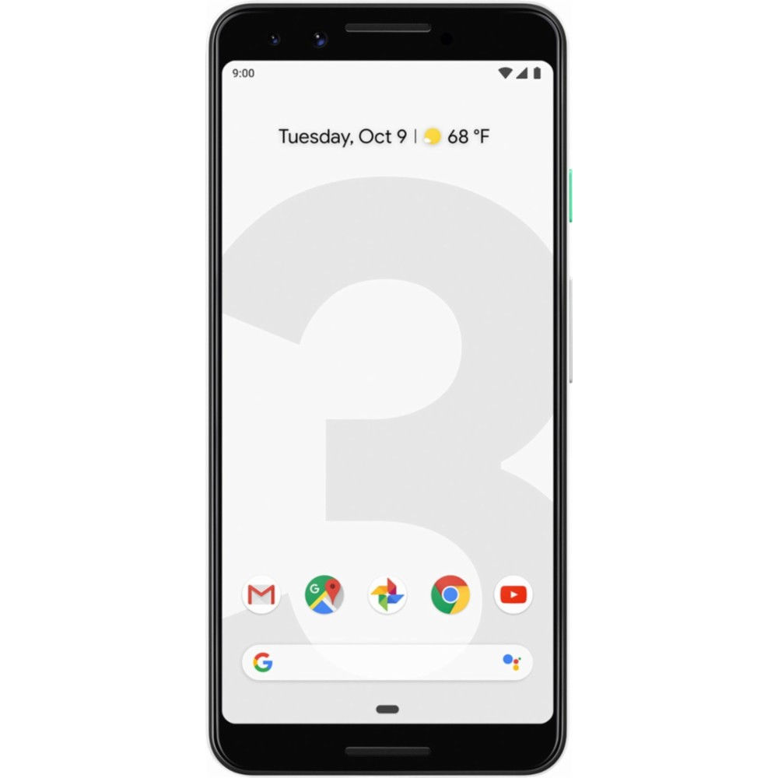
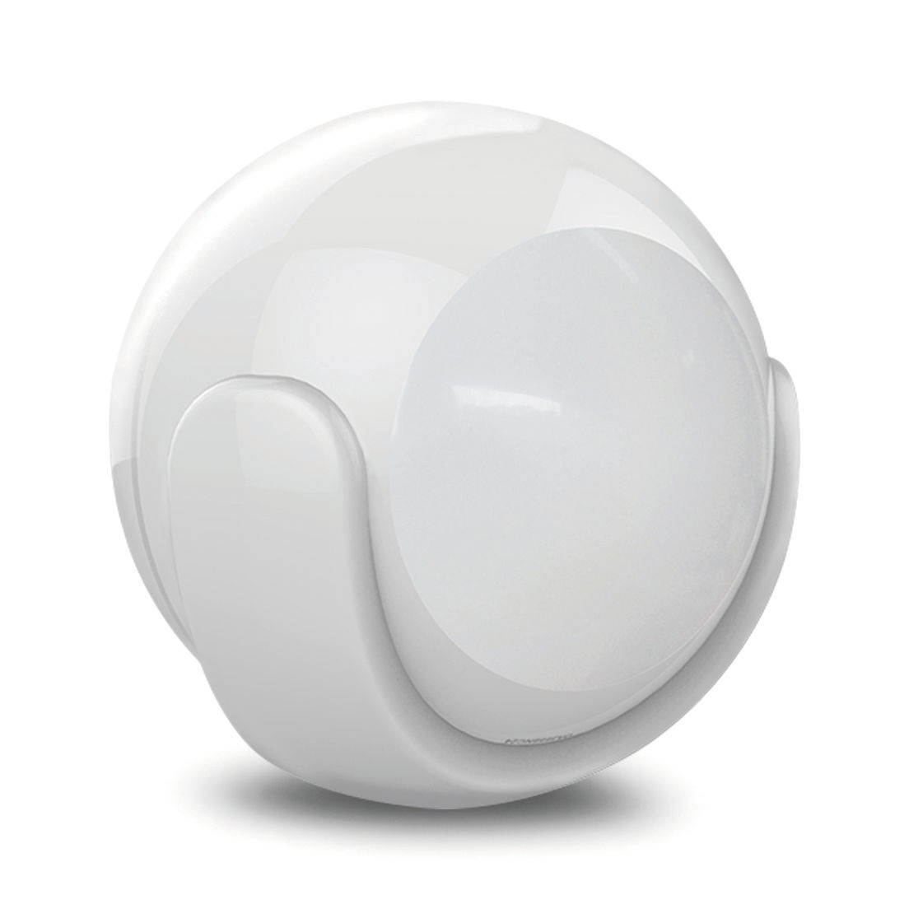
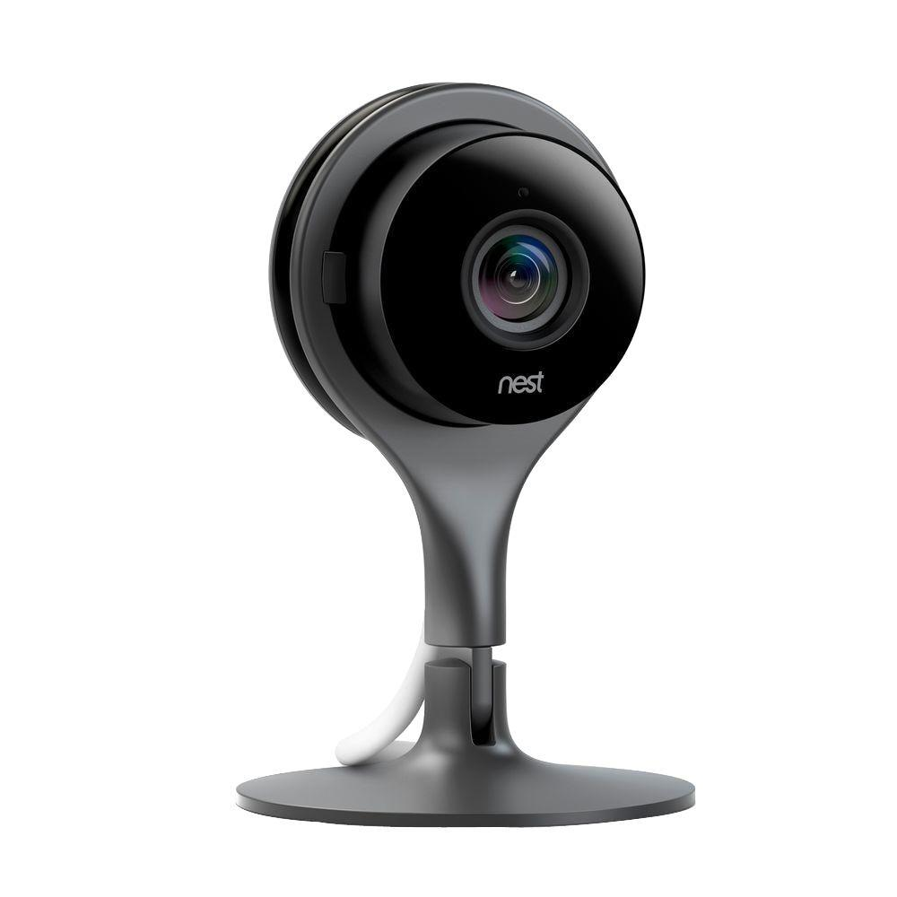
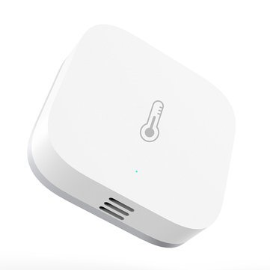
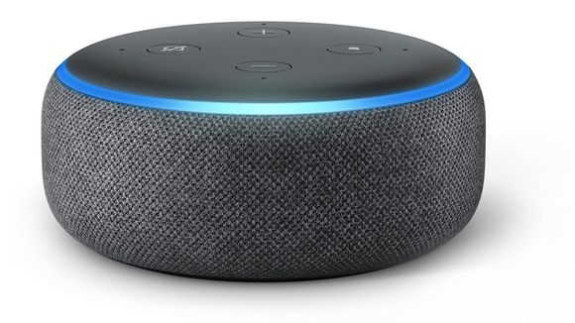
Background
Mobile and IoT devices are required to process not only simple tasks, but also computation-intensive tasks

Slide 4

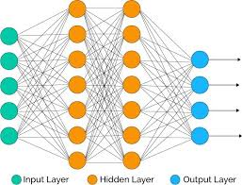

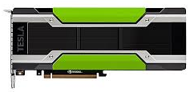
Background
Mobile and IoT devices are required to process not only simple tasks, but also computation-intensive tasks
However, these devices have a strict power and computation limit
The solution is to offload heavy tasks to the cloud
My Cat Charlie
Compute in the Cloud
Notes:
Fix animation

Slide 5

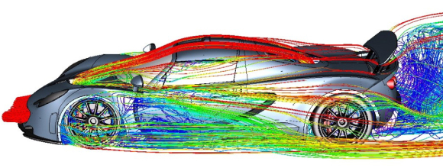
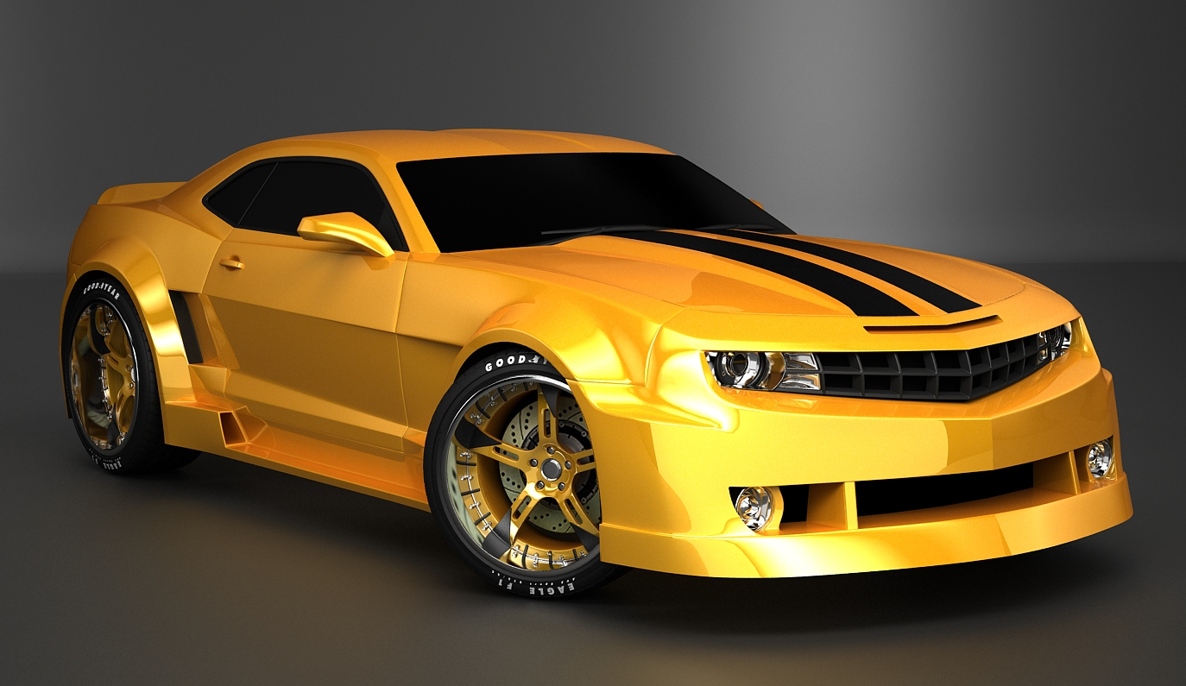


GPUs in the Cloud
GPUs in the cloud can accelerate a variety of tasks
Artificial Intelligence
Fluid Dynamics
3D Rendering
Is it safe to share GPU?
CAT
Biomedical Computation
Computer Vision

Slide 6
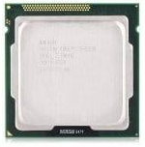
Comparison between CPU and GPU
CPU
GPU
Optimization
General Purpose
High throughput and parallelism
Processor
Complex, out-of-order
Many simple cores
Execution Model
Directly accessed by SW
Accessed through runtime
GPU has distinct vulnerabilities compared to CPU

Slide 7
Comparison between CPU and GPU
GPU
Side Channel Attacks:
Speculation based attacks do not work
GPU performance counters provides an easy access to side channels
[Luo’15], [Jiang’16], [Kadam’18], [Naghibijouybari’18], etc.
High throughput and parallelism
Many simple cores
Accessed through runtime
Library/Runtime-based Attacks:
Library and runtime can leak private data of GPU processes
[Lee’14], [Taft’16], [Yao’18], etc.

Slide 8
Threat Model in Prior Works
The attacker and victim share the same physical GPU,
And run in the same operating system
The attacker and victim share the same GPU runtime library
The attacker has access to GPU performance counters

Slide 9
GPU Virtualization
Recently, GPU vendors provided support for GPU virtualization
Goal of Virtualization:
  Better utilization of GPUs in the cloud
  More consistent performance across different users
  Easier management, etc.
With virtualization, every user has its own virtual GPU (vGPU)
Notes:
Attack model is time sharing
Show time sharing but with different VMs

Slide 10
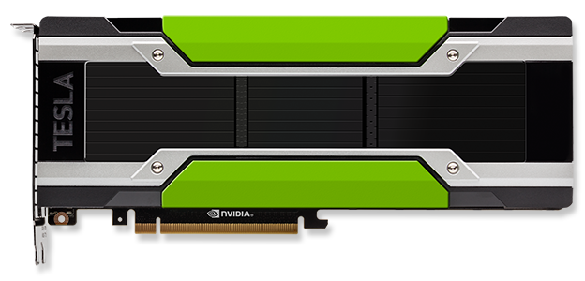
GPU Virtualization
VM3
VM2
VM4
VM1
VM5
VM6
GPU virtualization provides isolation among users

Slide 11
Outline
Background
Attack challenges and key ideas
Method Details
Evaluation
Conclusion

Slide 12
Do existing GPU attacks still work?
Side channel attacks
  Virtual GPUs do not have access to performance counters
  It is hard to launch side channel attacks
Library/runtime-based attacks
  Each virtual machine has an individual virtual GPU and software stack
  Existing attacks on library/runtime no long work
VM1
VM2
GPU Virtualization
Library
Library
Library
GPU
GPU

Slide 13
Threat Model Comparison
Without vGPU
With vGPUs
VM1
VM2
Library
Library
Library
GPU
GPU
Same Physical GPU
Share
Share
Operating System
Share
Separate VMs
GPU Library/Runtime
Share
Separate Libraries
Performance Counter
Yes
No
Is it possible to attack systems with virtualized GPUs?

Slide 14
Threat Model in This Work
The attacker and victim share the same physical GPU
But run in separate virtual machines and runtime libraries
The attacker has no access to GPU performance counters

Slide 15

Key Ideas
Virtualization prevents attacker from accessing private data through the library or runtime
Side channel attacks are still possible as VMs are physically co-located
VM1
VM2
VM1
VM2
Side channel
GPU
GPU

Slide 16
Key Idea I: Probe Activities
GPU consists of
  Processing elements
  Caches
  Memory
Even virtualized, these physical hardware components are still shared
The resource sharing can leak information about user’s activities
VM1
VM2
Processors
Cache
Memory
GPU

Slide 17


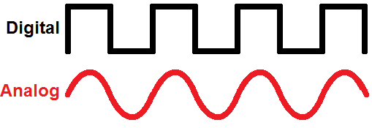
Key Idea I: Probe Activities
For example
  Computational intensive workloads occupy processing elements for a longer time
  Memory intensive workloads utilize more cache
  and memory resources
  Intensive workloads increase GPU clock frequency
Execution time of GPU programs can work as a performance counter
Our idea is to time simple probing programs (prober) to infer victim’s GPU program
VM1
VM2
Processors
Prober
Cache
Memory
GPU

Slide 18
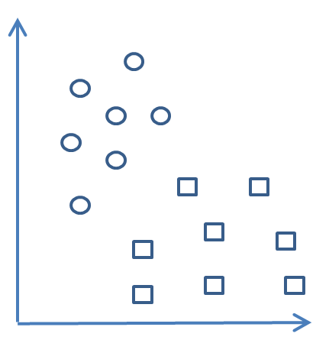





Key Idea II: Classify Activities
Prober has lower resolution compared to performance counter
Our idea is to use ML techniques to classify the victim’s activity
Prober
Performance
Counters
ML Model
Victim’s GPU Activity

Slide 19
Outline
Background
Attack challenges and key ideas
Method Details
Evaluation
Conclusion

Slide 20
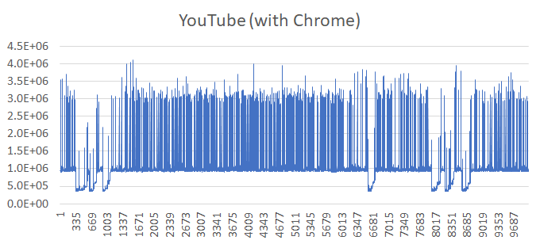
Probing Program
OpenCL Kernel*:
Time
__kernel void prober(
__global float* input
__global float* output
__global int idx)
{
output[idx]= input[idx]*input[idx];
}
Input and output array
A random location in array
Execution #
Execute N times
Time each execution
Fingerprint of victim
*Our attack is based on Intel’s integrated GPU

Slide 21
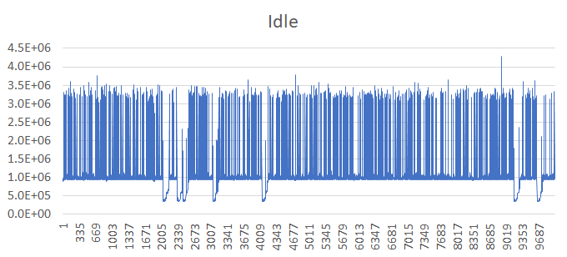
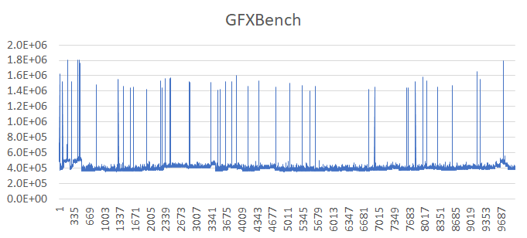
Fingerprint Classification
The trace of execution times (fingerprint) differs for different victim activities
Idle
GFXBench
4K Video
Time (ns)
Time (ns)
Time (ns)
Execution #
Execution #
Execution #

Slide 22
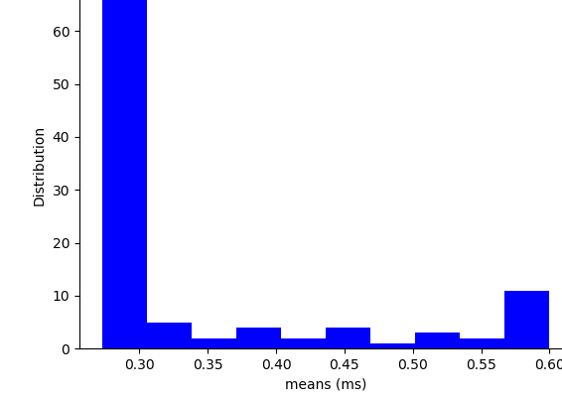

Fingerprint Classification
The trace of execution times (fingerprint) differs for different victim activities
We use machine learning techniques to classify victim’s activity
Idle
Time (ns)
Distribution
Execution #
Mean
Extract Features
(e.g., Mean, Skewness)
Select best features
Classification

Slide 23
Outline
Background
Attack challenges and key ideas
Method Details
Evaluation
Conclusion

Slide 24
System Configuration
Host Machine
Hardware
CPU: Intel i7 6700, 8 logical cores
GPU: Intel GT2 HD530
Memory: 48GB DDR4
Software
OS: Ubuntu 16.04
Kernel: 4.17 (w/ Intel GVT*)
QEMU: 2.12 (w/ Intel GVT)
Virtual Machine
Hardware
CPU: 2 logical cores
GPU: Intel virtual GPU
Memory: 4GB
Software
OS: Ubuntu 16.04
Kernel: 4.15
*GVT stands for Intel Graphics Virtualization Technology

Slide 25
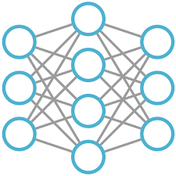
System Configuration
Victim
Attacker
Virtual Machine
Hardware
CPU: 2 logical cores
GPU: Intel virtual GPU
Memory: 4GB
Software
OS: Ubuntu 16.04
Kernel: 4.15
VM1
VM2
Virtual Machines
Prober
Runtime
Runtime
Intel vGPU
Intel vGPU
KVM + QEMU
Host Machine
Linux with Intel GVT
Intel GPU

Slide 26
GPU Applications (Victim)
Category | Activity (Application) | Description
Baseline | Idle | No GPU load
Entertainment | Video Streaming | Watch 4K YouTube video
 | OpenArena Game | Play OpenArena
Deep Learning | VGG-16 | Deep learning models developed on clDNN framework (OpenCL-based)
 | AlexNet
 | GoogleLeNet-V1 GoogleLeNet-V2 GoogleLeNet-V4

Slide 27

Classification Accuracy
Classifier | Prec. | Recall | F1* | Prec. | Recall | F1
Random Forest | 0.96 | 0.95 | 0.95 | 1.00 | 1.00 | 1.00
K-Nearest Neighbors | 0.82 | 0.82 | 0.82 | 1.00 | 1.00 | 1.00
Support Vector Machine | 0.95 | 0.95 | 0.95 | Not converge
Adaptive Boosting | 0.86 | 0.85 | 0.85 | 0.47 | 0.60 | 0.50
Naïve Bayes | 0.74 | 0.71 | 0.69 | 0.92 | 0.90 | 0.90
 | User Activities (Entertainment) |  |  | Deep Learning Models
We can achieve high accuracy in identifying other user’s activity
*Equation for F1 score: $F_{1}=2×\frac{Prec×Recall}{Prec+Recall}$

Slide 28
Future Work
Evaluate other GPU virtualization systems (e.g., NVIDIA platform)
Use multiple probers to extract more detailed information
Evaluate multiple virtual GPUs and more GPU applications
Security-hardware co-design for future GPU architectures

Slide 29
Conclusion
Sharing GPU in the cloud has potential security concerns
The recent GPU virtualization support eliminates existing attacks
This work demonstrates even with GPU virtualization, we can still perform side channel attacks
Our approach:
  Use probing program as “performance counters”
  Use machine learning model to classify GPU workloads (activities)
We achieve high accuracy in detecting these workloads

Slide 30
Side Channel Attacks in
Computation Offloading Systems with GPU Virtualization
Sihang Liu, Yizhou Wei, Jianfeng Chi, Faysal Hossain Shezan, Yuan Tian
University of Virginia
Contact: Sihang Liu sihangliu@virginia.edu
Yuan Tian yuant@virginia.edu

